Slide 1
Symbolic matlab toolbox
Dr vahidipour
---
-----

Slide 2
Symbolic Math Toolbox

Slide 3
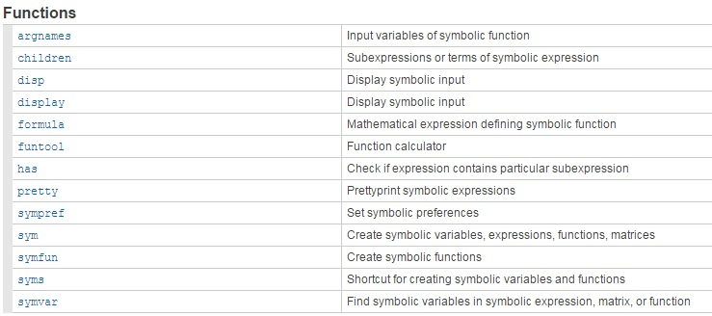
Symbolic Variables, Expressions, Functions, and Preferences

Slide 4
Create Symbolic Variables & Create Symbolic Vector & Create Symbolic Matrices

Slide 5
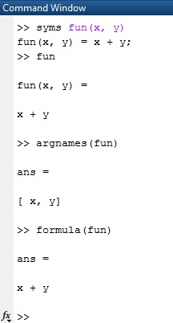
Argnames & formula
formula :Mathematical expression defining symbolic function
Argnames :Input variables of symbolic function

Slide 6
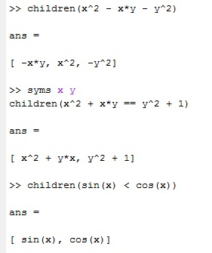
children
Subexpressions or terms of symbolic expression symbolic
Examples:
Find the child subexpressions of this expression.
Find the child subexpressions of this equation.
Find the child subexpressions of this inequality.

Slide 7
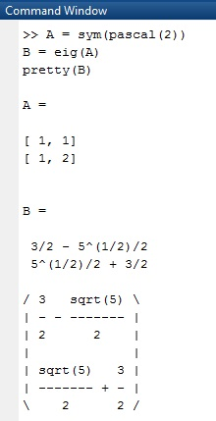
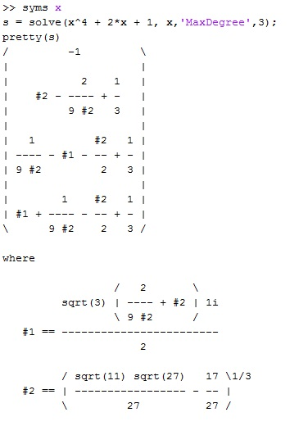
pretty
Prettyprint symbolic expressions

Slide 8
Has Description
Check if expression contains particular subexpression
has(expr,subexpr) returns logical 1 (true) if expr contains subexpr. Otherwise, it returns logical 0 (false).
If expr is an array, has(expr,subexpr) returns an array of the same size as expr.
The returned array contains logical 1s (true) where the elements of expr contain subexpr,
and logical 0s (false) where they do not.
If subexpr is an array, has(expr,subexpr) checks if expr contains any element of subexpr.

Slide 9
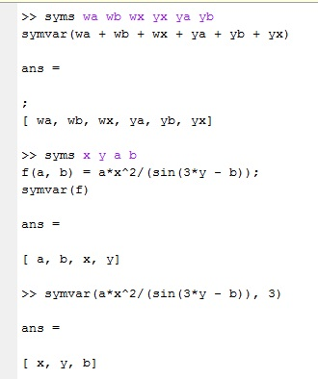
symvar
Find symbolic variables in symbolic expression, matrix, or function
symvar(s) can return variables in a different order than symvar(s,n).
symvar does treat the constants pi, i, and j as variables.
If there are no symbolic variables in s, symvar returns the empty vector.

Slide 10
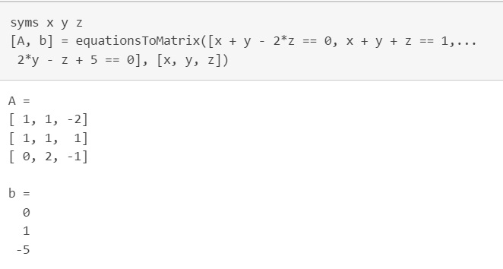
Linear and Nonlinear Equations and Systems

Slide 11
Graphics

Slide 12
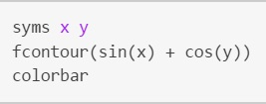
fcontour(f) plots the contour lines of symbolic expression f(x,y) over the default interval of x and y, which is [-5 5]

Slide 13
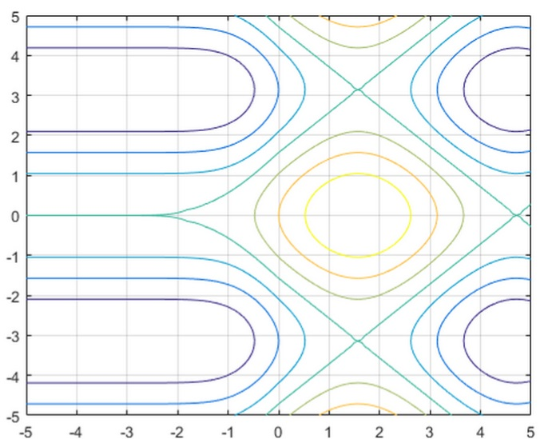

Slide 14
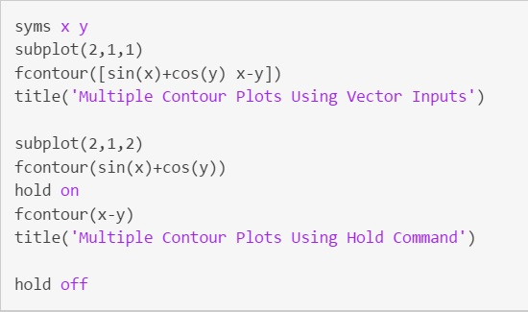

Slide 15
fmesh(f) creates a mesh plot of the symbolic expression f(x,y) over the default interval [-5 5] for x and y.

Slide 16
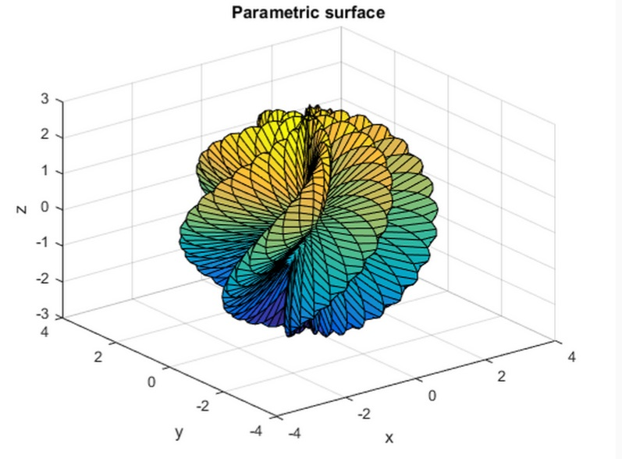
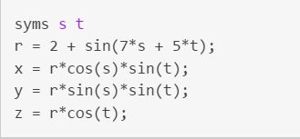
fsurf(f) creates a plot 3-D surface of the symbolic expression f(x,y)

