Slide 1
Closed Patterns and Max Patterns
Presented by: Atefeh Rahimi
Hadiseh Mohammdi
Bahareh Hajihashemi
Adviser: Dr. Vahidipour

Slide 2
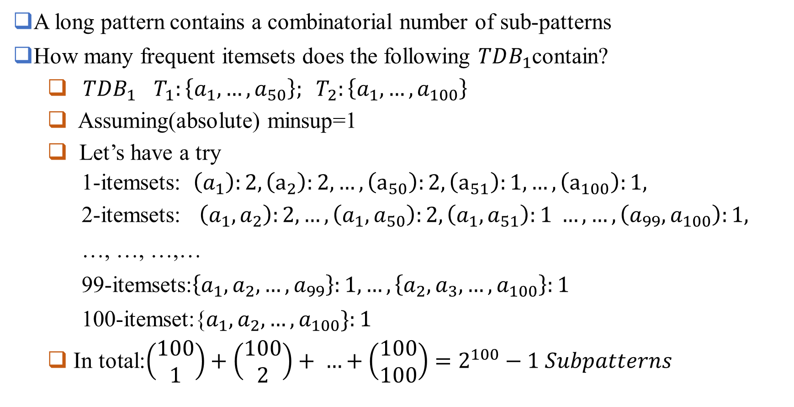
Challenge: There Are Too Many Frequent patterns!
A long pattern contains a combinatorial number of sub-patterns
How many frequent itemsets does the following $TDB_{1}$contain?
$TDB_{1}$ $T_{1}:\left\{a_{1},…, a_{50}\right\}; T_{2}:\left\{a_{1}, …,a_{100}\right\}$
Assuming(absolute) minsup=1
Let’s have a try
1-itemsets: $\left(a_{1}\right):2, \left(a_{2}\right):2, …,\left(a_{50}\right):2,\left(a_{51}\right):1, …,\left(a_{100}\right):1,$
2-itemsets: $\left(a_{1},a_{2}\right):2, …,\left(a_{1},a_{50}\right):2,\left(a_{1},a_{51}\right):1 …,…,\left(a_{99},a_{100}\right):1,$
…, …, …,…
99-itemsets:$\left\{a_{1},a_{2}, …,a_{99}\right\}:1,…, \left\{a_{2}, a_{3}, …,a_{100}\right\}:1$
100-itemset:{$a_{1}, a_{2}, …,a_{100}\}:1$
In total:$\left(\begin{aligned}100 \\ 1\end{aligned}\right)+\left(\begin{aligned}100 \\ 2\end{aligned}\right)+ …+\left(\begin{aligned}100 \\ 100\end{aligned}\right)=2^{100}−1 Subpatterns$
A too huge set for
Any computer to compute or store!

Slide 3
Solutions
Closed patterns
Max patterns

Slide 4
Expressing Patterns in Compressed Form: Closed Patterns
How to handle such a challenge?
Solution 1: Closed patterns: A Pattern(itemset)X is closed if X is frequent, and there exists no super-pattern Y$⊃$X, with the same support as X.
Let Transaction DB $TDB_{1}$: $T_{1}:\left\{a_{1},…,a_{50}\right\}; T_{2}:\left\{a_{1},…, a_{100}\right\}$
Suppose minsup = 1. How many closed patterns does $TDB_{1}$contain?
Two: $P_{1}:"\left(a_{1}, …,a_{50}\right):2“$; $P_{2}:"\left(a_{1}, …, a_{100}\right):1$”
Closed pattern is a lossless compression of frequent patterns.
Reduces the # of patterns but does lose the support information!
You will still be able to say: “$\left(a_{2}, …, a_{40}\right):2$” , “ $\left(a_{5},a_{51}\right):1$”

Slide 5
Expressing Patterns in Compressed Form: Max-Patterns
Solution 2: Max-patterns: A pattern X is a max-pattern if X is frequent and there exists no frequent super-pattern Y$⊃$ X.
Difference from close-patterns?
Do not care the real support of sub-patterns of a max-pattern.
Let Transaction DB $TDB_{1}$ $T_{1}:\left\{a_{1},…, a_{50}\right\}; T_{2}:\left\{a_{1}, …,a_{100}\right\}$
Suppose minsup= 1. How many max-patterns does $TDB_{1}$ contain?
One: “$\left\{a_{1},a_{2}, a_{3}, …,a_{100}\right\}:1$”
Max-pattern is a lossy compression!
We only Know ($a_{1},…, a_{40})$is frequent.
But we do not know the real support of ($a_{1},…, a_{40})$, …,any more!

Slide 6
Difference between Closed patterns and Max patterns
In the case of closed patterns by adding one item, support is decreased it means possibility of a purchase or an order will be decreased but in the case of maximal patterns adding an item will not only decrease support, but also convert that order from a common order to a particular order.

Slide 7
Example
{A},{C},{E},{A,D} are closed frequent itemsets
{C},{E},{A,D} are maximal.
{A} is not maximal.
Frequent itemsets
{A}:3 | {C,D}:1
{B}:1 | {C,E}:1
{C}:2 | {A,B,C}:1
{D}:2 | {A,B,D}:1
{E}:2 | {A,B,E}:0
{A,B}:1 | {B,C,D}:1
{A,C}:1 | {B,C,E}:0
{A,D}:2 | {C,D,E}:0
{A,E}:1 | {A,B,C,D}:1
{B,C}:1 | {A,B,C,E}:0
{B,D}:1 | {B,C,D,E}:0
{B,E}:0 | {A,C,D,E}:0
{A,B,C,D,E}:0 | {A,B,D,E}:0
TID | Items in the transactions
T1 | {A,B,C,D}
T2 | {A,D}
T3 | {A,E}
T4 | {C,E}
{A} is closed because none of its supersets have the same support as itself
But {A} is not maximal because {A,D} is superset of {A} and is frequent
Why {D} is not closed?

Slide 8
Algorithm for mining max, closed sequential patterns

Slide 9
What do you infer from this?
All maximal frequent itemsets are closed frequent itemsets but the converse is not true.
Frequent itemsets
Closed frequent itemsets
Maximal frequent itemsets

Slide 10
Thank You

