Slide 1
Random Forests
Advisor: Dr.vahidipour
Zahra salimian
Shaghayegh jalali
Dec 2017

Slide 2
Abstract
(RF) are a combination of tree predictors such that each tree depends on the values of a random vector sampled independently and with the same distribution for all trees in the forest.

Slide 3
The generalization error of a forest of tree classifiers depends on the strength of the individual trees in the forest and the correlation between them.

Slide 4
Using a random selection of features to split each node yields error rates that compare favorably to Adaboost, and are more robust with respect to noise.

Slide 5
Random forests include three main tuning parameters.
Node Size: unlike in decision trees, the number of observations in the terminal nodes of each tree of the forest can be very small. The goal is to grow trees with as little bias as possible.
Number of Trees: in practice, 500 trees is often a good choice.
Number of Predictors Sampled: the number of predictors sampled at each split would seem to be a key tuning parameter that should affect how well random forests perform. Sampling 2-5 each time is often adequate.

Slide 6
Random forest
As in bagging, we build a number of decision trees on bootstrapped training samples each time a split in a tree is considered, a random sample of m predictors is chosen as split candidates from the full set of p predictors.
Note that if m = p, then this is bagging.

Slide 7
Random Forests Algorithm
For b = 1 to B:
(a) Draw a bootstrap sample Z∗ of size N from the training data.
(b) Grow a random-forest tree to the bootstrapped data, by recursively repeating the
following steps for each terminal node of the tree, until the minimum node size n_{min} is reached.
i. Select m variables at random from the p variables.
ii. Pick the best variable/split-point among the m.
iii. Split the node into two daughter nodes.
Output the ensemble of trees.
To make a prediction at a new point x we do:
For regression: average the results
For classification: majority vote

Slide 8
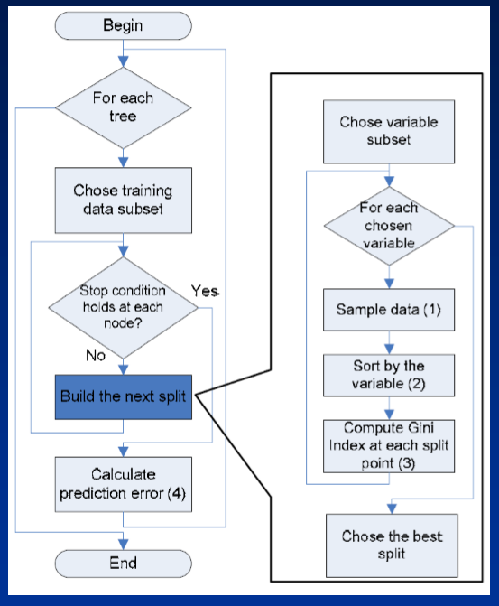

Slide 9
Random Forests Tuning
The inventors make the following recommendations:
For classification, the default value for m is √p and the minimum node size is one.
For regression, the default value for m is p/3 and the minimum node size is five.
In practice the best values for these parameters will depend on the problem, and they should be treated as tuning parameters.

Slide 11
Example
4,718 genes measured on tissue samples from 349 patients.
Each gene has different expression
Each of the patient samples has a qualitative label with 15 different levels: either normal or 1 of 14 different types of cancer.
Use random forests to predict cancer type based on the 500 genes that have the largest variance in the training set.

Slide 12
Random forest: sample results
RF retains many benefits of decision trees …
Handles missing values,
continuous and categorical predictors
while achieving results that decision trees cannot:
RF does not require tree pruning to generalize
Over variety of problem domains, RF improves prediction

Slide 13
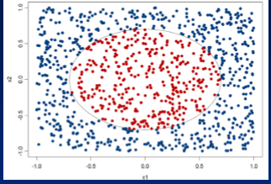
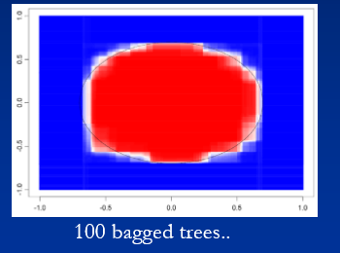
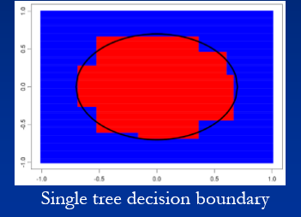
Bagging: reduces variance –Example
Ellipsoid separation
Two categories
Two predictor

Slide 14
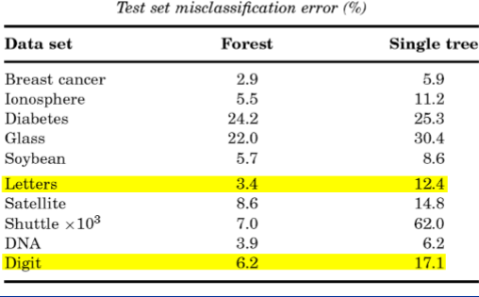
accuracy compared to single trees:

Slide 15
Comparisons: random forest vs SVMs, neural networks
Random forests have about same accuracy as SVMs and neural networks
RF is more interpretable
Feature importance can be estimated during training for little additional computation
plotting of sample
Visualization of output decision trees
RF readily handles larger numbers of predictors.
Faster to train
Has fewer parameters

Slide 16
Comparisons:random forest vs boosting
Main similarities:
Both derive many benefits from ensembling, with few disadvantages
Both can be applied to ensembling decision trees.
Main differences:
Boosting performs an exhaustive search for best predictor to split on; RF searches only a small subset
Boosting grows trees in series, with later trees dependent on the results of previous trees; RF grows trees in parallel independently of one another.

Slide 17
Can RF overfit?
Random forests “cannot overfit” the data with respect to number of trees.
The number of trees, B does not mean increase in the flexibility of the model

Slide 18
Conclusions

Slide 19
Fast fast fast!
RF is fast to build. Even faster to predict!
Practically speaking, not requiring cross-validation alone for model selection significantly by 10x-100x or more. speeds training
Fully parallelizable …to go even faster!
Automatic predictor selection from large number of candidates
RF can be used for feature selection alone; or to streamlining other, slower learners

Slide 20
Resistance to over training
Ability to handle data without preprocessing
data does not need to be rescaled, transformed, or modified
automatic handling of missing values
Cluster identification
Interpretability
Predictor importance, sample proximity and tree structure offer insights into data

Slide 21
References
Leo Breiman, Random Forests, Machine Learning, 45, 5-32, 2001
http://www.stat.berkeley.edu/~breiman/RandomForests/

Slide 22
Thank you

