Slide 1
Sequential Covering Algorithm
ارایه درس مبانی داده کاوی
استاد درس: استاد وحیدی پور
تهیه کننده: میلاد چراغی
دانشگاه کاشان
دی ماه 1396

Slide 2
Rule Learning Approaches
Translate decision trees into rules (C4.5)
Sequential (set) covering algorithms
General-to-specific (top-down) (CN2, FOIL)
Specific-to-general (bottom-up) (GOLEM, CIGOL)
2

Slide 3
Sequential Covering
A set of rules is learned one at a time, each time finding a single rule that covers a large number of positive instances without covering any negatives, removing the positives that it covers, and learning additional rules to cover the rest.
Let P be the set of positive examples Until P is empty do:
Learn a rule R that covers a large number of elements of P but
no negatives.
Add R to the list of rules.
Remove positives covered by R from P
This is an instance of the greedy algorithm for minimum set covering and does not guarantee a minimum number of learned rules.
3

Slide 4
Greedy Sequential Covering Example
Y
+
+
+
+
+
+
+
+
+
+
+
+ +
X
4

Slide 5
Greedy Sequential Covering Example
Y
+
+
+
+
+
+
+
+
+
+
+
+ +
X
5

Slide 6
Greedy Sequential Covering Example
Y
+
+
+
+
+ +
X
6

Slide 7
Greedy Sequential Covering Example
Y
+
+
+
+
+ +
X
7

Slide 8
Greedy Sequential Covering Example
Y
+
+ +
X
8

Slide 9
Greedy Sequential Covering Example
Y
+
+ +
X
9

Slide 10
Greedy Sequential Covering Example
Y
X
10

Slide 11
No-optimal Covering Example
Y
+
+
+
+
+
+
+
+
+
+
+
+ +
X
11

Slide 12
Greedy Sequential Covering Example
Y
+
+
+
+
+
+
+
+
+
+
+
+ +
X
12

Slide 13
Greedy Sequential Covering Example
Y
+
+
+
+
+ +
X
13

Slide 14
Greedy Sequential Covering Example
Y
+
+
+
+
+ +
X
14

Slide 15
Greedy Sequential Covering Example
Y
+
+
X
15

Slide 16
Greedy Sequential Covering Example
Y
+ | +
X
16

Slide 17
Greedy Sequential Covering Example
Y
+
X
17

Slide 18
Greedy Sequential Covering Example
Y
 |  | +
X
18

Slide 19
Greedy Sequential Covering Example
Y
X
19

Slide 20
Strategies for Learning a Single Rule
Top Down (General to Specific):
Start with the most-general (empty) rule.
Repeatedly add antecedent constraints on features that eliminate negative examples while maintaining as many positives as possible.
Stop when only positives are covered.
Bottom Up (Specific to General)
Start with a most-specific rule (e.g. complete instance description of a random instance).
Repeatedly remove antecedent constraints in order to cover more positives.
Stop when further generalization results in covering
negatives.

Slide 21
Top-Down Rule Learning Example
Y
+
+
+
+
+
+
+
+
+
+
+
+ +
X

Slide 22
Top-Down Rule Learning Example
Y
+
+
+
+
+
+
Y>C
+
1
+
+
+
+
+ +
X

Slide 23
Top-Down Rule Learning Example
Y
+
+
+
+
+
+
Y>C
+
1
+
+
+
+
+ +
X
X>C₂

Slide 24
Top-Down Rule Learning Example
Y
Y<C₃
+
+
+
+
+
+
Y>C
+
1
+
+
+
+
+ +
X
X>C₂

Slide 25
Top-Down Rule Learning Example
Y
Y<C₃
+
+
+
+
+
+
Y>C
+
1
+
+
+
+
+ +
X
X>C₂
X<C₄

Slide 26
Bottom-Up Rule Learning Example
Y
+
+
+
+
+
+
+
+
+
+
+
+ +
X

Slide 27
Bottom-Up Rule Learning Example
Y
+
+
+
+
+
+
+
+
+
+
+
+ +
X

Slide 28
Bottom-Up Rule Learning Example
Y
+
+
+
+
+
+
+
+
+
+
+
+ +
X

Slide 29
Bottom-Up Rule Learning Example
Y
+
+
+
+
+
+
+
+
+
+
+
+ +
X

Slide 30
Bottom-Up Rule Learning Example
Y
+
+
+
+
+
+
+
+
+
+
+
+ +
X

Slide 31
Bottom-Up Rule Learning Example
Y
+
+
+
+
+
+
+
+
+
+
+
+ +
X

Slide 32
Bottom-Up Rule Learning Example
Y
+
+
+
+
+
+
+
+
+
+
+
+ +
X

Slide 33
Bottom-Up Rule Learning Example
Y
 | + ₊
+ ₊
+ + +
+
+
+
+
+ +
X

Slide 34
Bottom-Up Rule Learning Example
Y
+
+
+
+
+
+
+
+
+
+
+
+ +
X

Slide 35
Bottom-Up Rule Learning Example
Y
+
+
+
+
+
+
+
+
+
+
+
+ +
X

Slide 36
Bottom-Up Rule Learning Example
Y
+
+
+
+
+
+
+
+
+
+
+
+ +
X

Slide 37
Basic Sequential Covering Algorithm

Slide 38
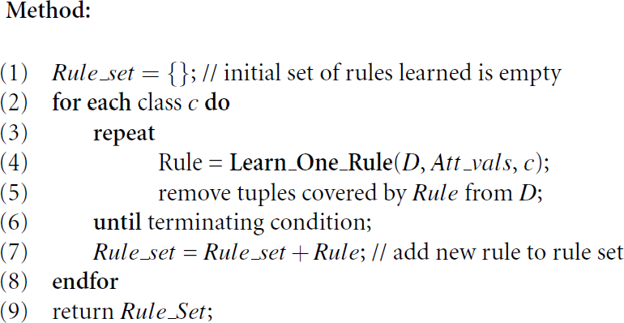
Basic Sequential Covering Algorithm

Slide 39
Basic Sequential Covering Algorithm
Steps:
Rules are learned one at a time
Each time a rule is learned, the instances covered by the rules are removed
The process repeats on the remaining instances unless termination condition
e.g., when no more training examples or when the quality of a rule returned is below a user-specified level

Slide 40
Foil Algorithm
(First Order Inductive Learner Algorithm)

Slide 41
FOIL Algorithm
Top-down approach originally applied to first-order logic (Quinlan, 1990).

Slide 42
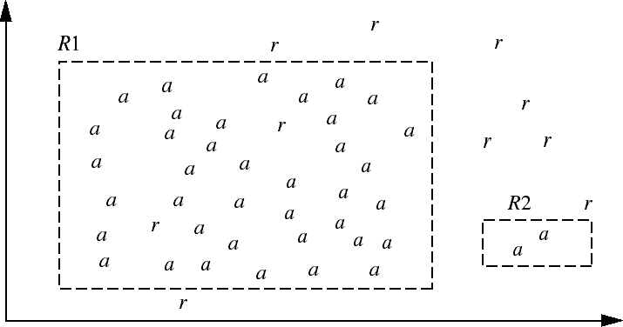
Coverage or Accuracy?

Slide 43
Coverage or Accuracy?
Consider the two rules:
R1: correctly classifies 38 of the 40 instances it covers
R2: covers only two instances, which it correctly classifies
Their accuracies are 95% and 100%
R2 has greater accuracy than R1, but it is not the better rule because of its small coverage
Accuracy on its own is not a reliable estimate of rule quality
Coverage on its own is not useful either

Slide 44
Consider Both Coverage and Accuracy
If our current rule is R:
IF condition THEN class = c
We want to see if logically ANDing a given attribute test to condition would result in a better rule
We call the new condition, condition’, where R’ : IF condition’ THEN class = c
– is our potential new rule
In other words, we want to see if R’ is any better than R

Slide 45
FOIL Information Gain
FOIL_Gain (in FOIL & RIPPER): assesses info_gain by extending condition
pos ' pos
FOIL _Gain = pos ' × (log
where
− log
)
2
2
pos '+ neg ' pos + neg
pos (neg) be the number of positive (negative) instances covered by R
pos’ (neg’) be the number of positive (negative) instances covered by R’
It favors rules that have high accuracy and cover many positive instances

Slide 46
Rule Generation
To generate a rule
while(true)
find the best predicate p
if FOIL_GAIN(p) > threshold then add p to current rule
else break
A3=1&&A1=2
&&A8=5
A
3
=
1
&
&
A
1
=
2
A
3
=
1
Positive examples
Negative examples

Slide 47
Rule Pruning: FOIL method
Assessments of rule quality as described above are made with instances from the training data
Rule pruning based on an independent set of test instances
If FOIL_Prune is higher for the pruned version of R, prune R

Slide 48
RIPPER Algorithm

Slide 49
Direct Method: RIPPER
Growing a rule:
Start from empty rule
Add conjuncts as long as they improve FOIL’s
information gain
Stop when rule no longer covers positive examples
Prune the rule immediately using incremental reduced error pruning
Measure for pruning: v = (p-n)/(p+n)
p: number of positive examples covered by the rule in the validation set
n: number of negative examples covered by the rule in the validation set
Pruning method: delete any final sequence of conditions that maximizes v

Slide 50
Thank You

