Slide 1
Clementine
Data Mining Presentation
Lecturer:Dr.vahidipour
Presenters:
Nastaran Jafari,Zahra Bayat,Sara Ghorbani

Slide 2
Agenda
What is clementine?
What is the point of Statistical Analysis?
CHAID Algorithm
CART and c5.0 Algorithm
Useful teaching resources
Questions?

Slide 3
What is clementine?
Statical Analytical Software used for data
Released in 1968 and acquired in 2009 by IBM;formerly know as clementine
Enables the user to easily import,manage and analyze their data in a user-friendly graphical user interface.
Allows the user to import from a variety of sources including databases(SQL,Oracle),flat files,Excel and XML

Slide 4
What is clementine?
Clementine allows the user to easily construct graphs &
charts,tables,cross- tabulations,build forecasting models,decision-
trees,and perform a number of advanced statistical functions and
export them to the desired format

Slide 5
What is the point of Statistical Analysis?
To use a sample of data to make predictios about a larger
population
To understand what decisions will cause a company to lose/make
money
To understand which clients are high risk/low risk
To make better planning decisions

Slide 6
What is the point of Statistical Analysis?
Collecting Data, Analyzing Data, and Making Predictions from that analysis is known as sound Research.
Research is the backbone of why we have certain processes in place in the fields of medicine.finance, education , retail

Slide 7
Decision Tree Analysis
Decesion-Tree Analysis: the purpose of a decision tree analysis is to
model a series of events and look at how it affects an outcome (such as
sale units).it calculates a set of conditional probabilities based on different
scenarios.

Slide 8
Decision Tree Analysis
Can be used in variety of industries including retail,
healthcare , education , finance to name a few.
3-minute demonstration in retail setting

Slide 9
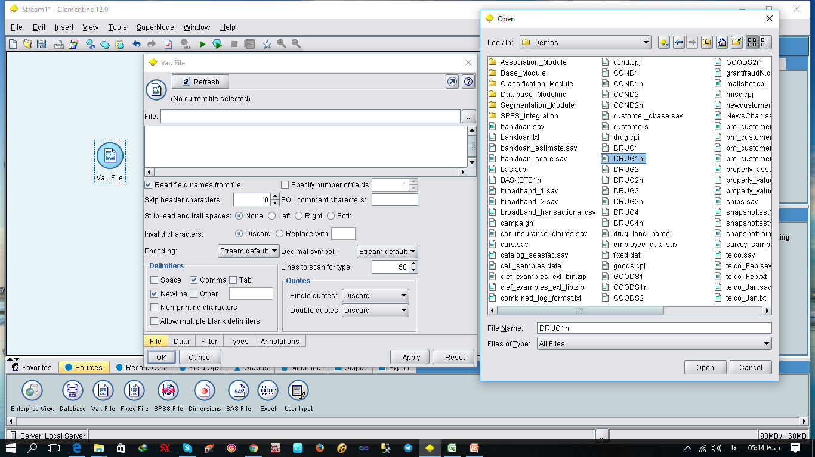
Dataset in Clementine

Slide 10
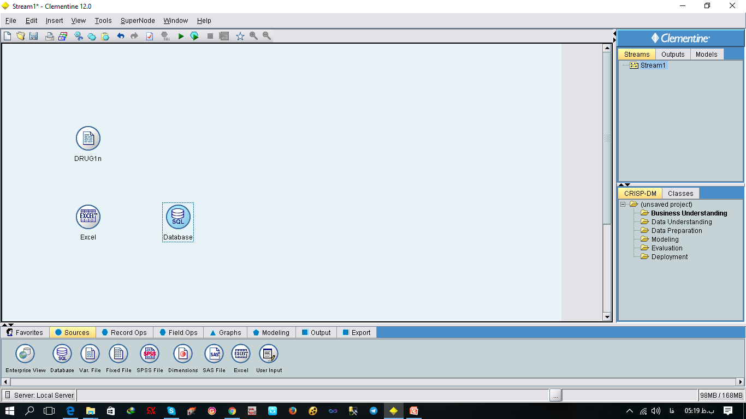
Other Dataset in Clementine

Slide 11
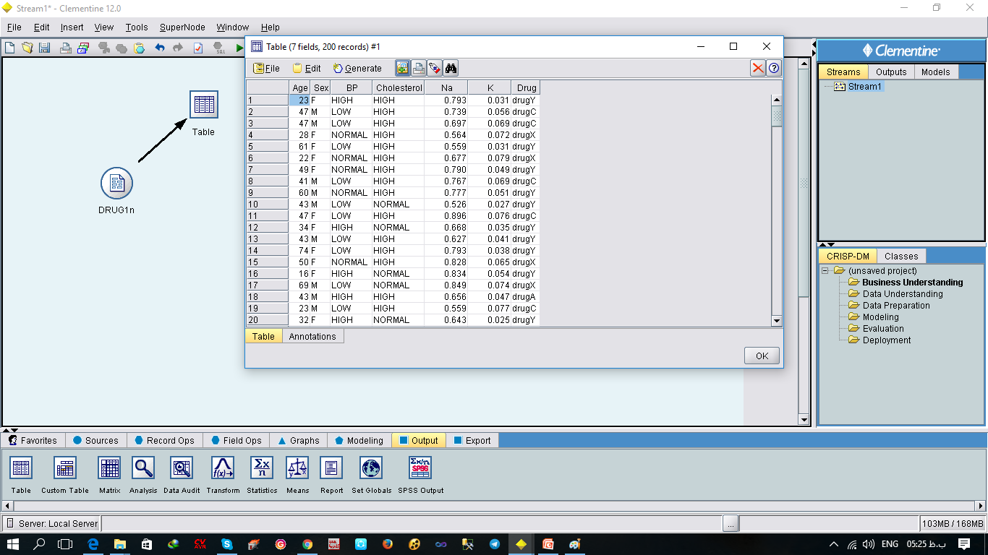
Display Dataset in Table

Slide 12
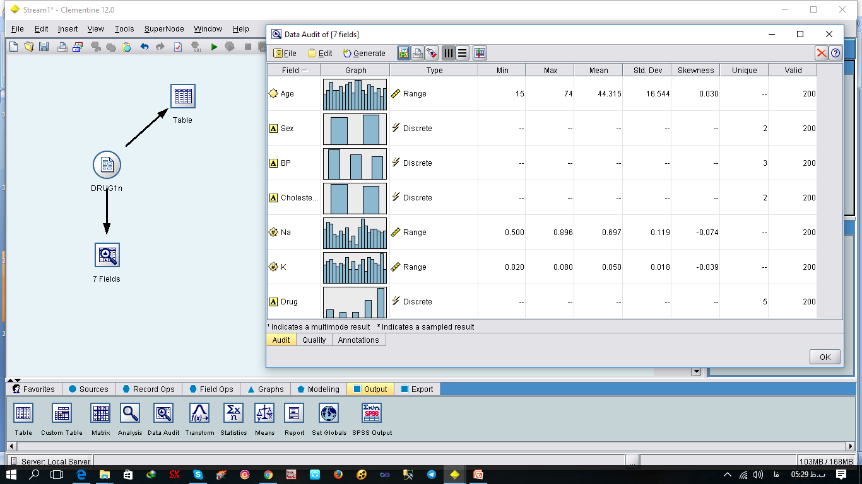
Descriptive statistics in clementine

Slide 13
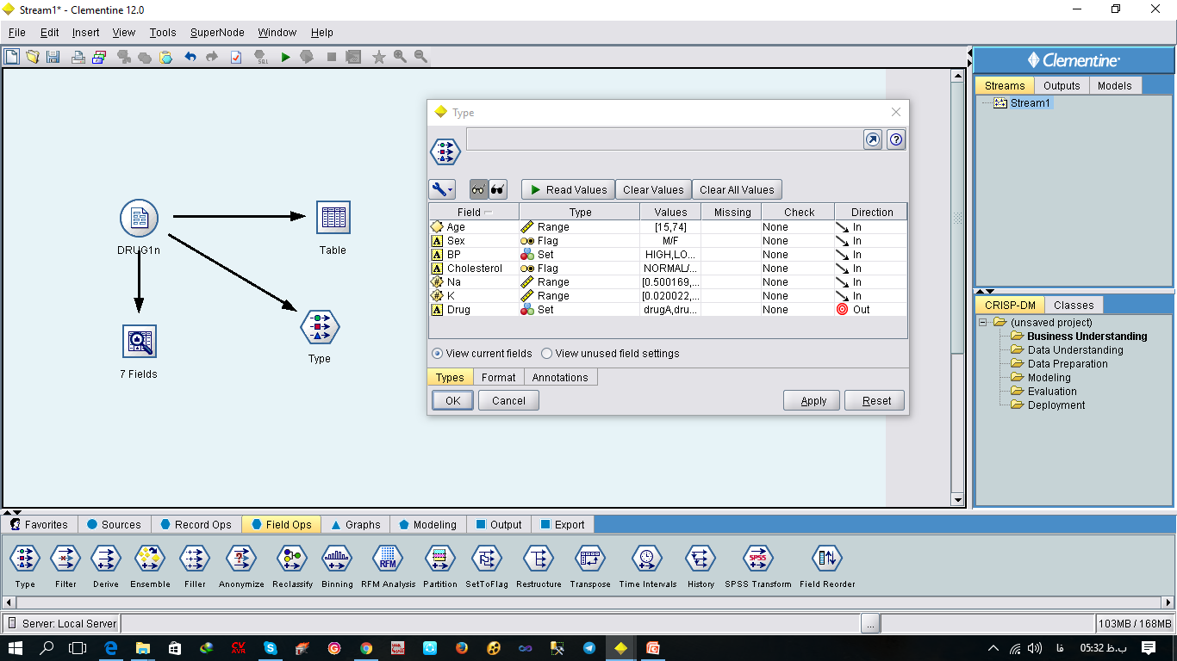
Read value and Direction in Clementine

Slide 14
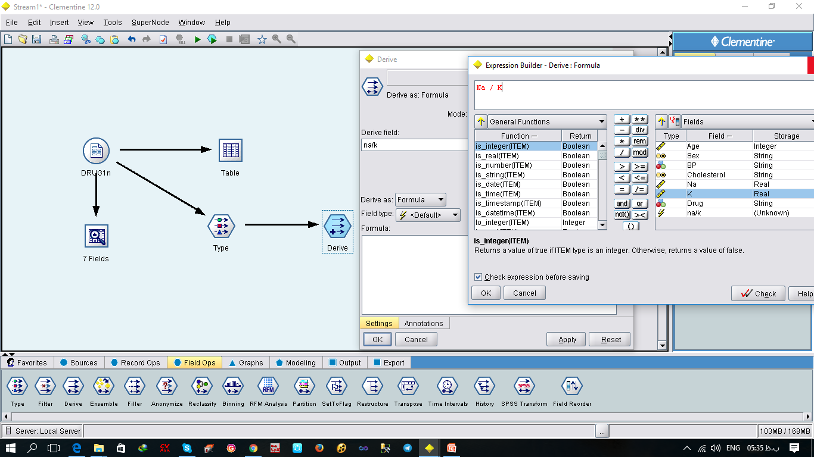
Drive Node in Clementine

Slide 15
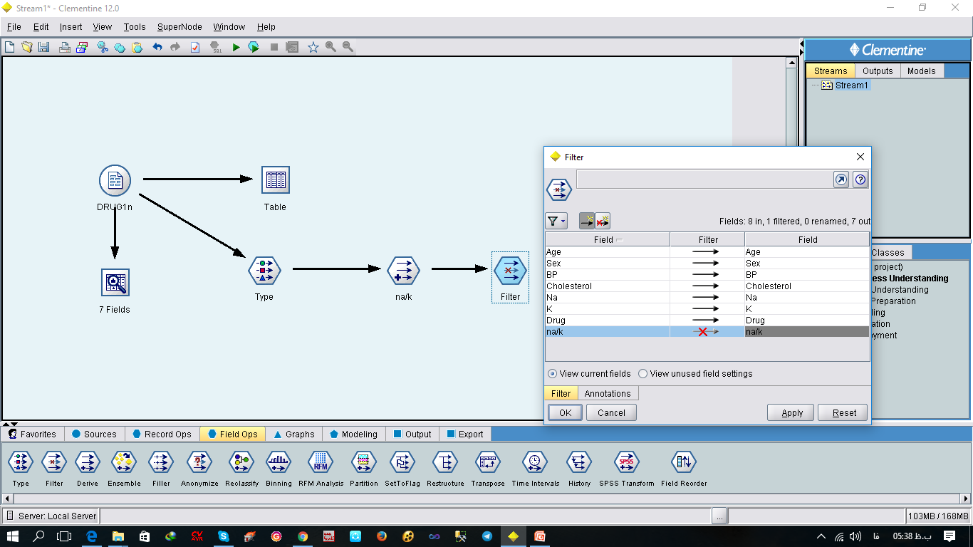
Filter Node in Clementine

Slide 16
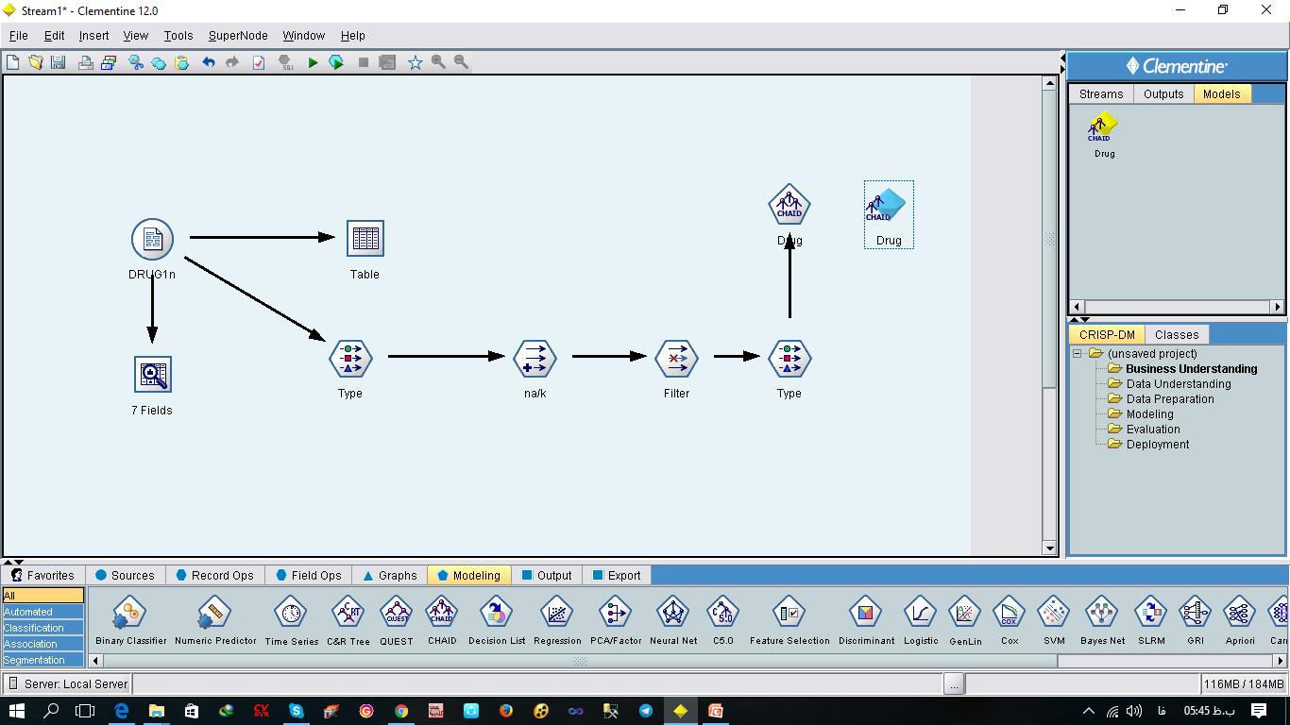
CHAID Algorithm

Slide 17
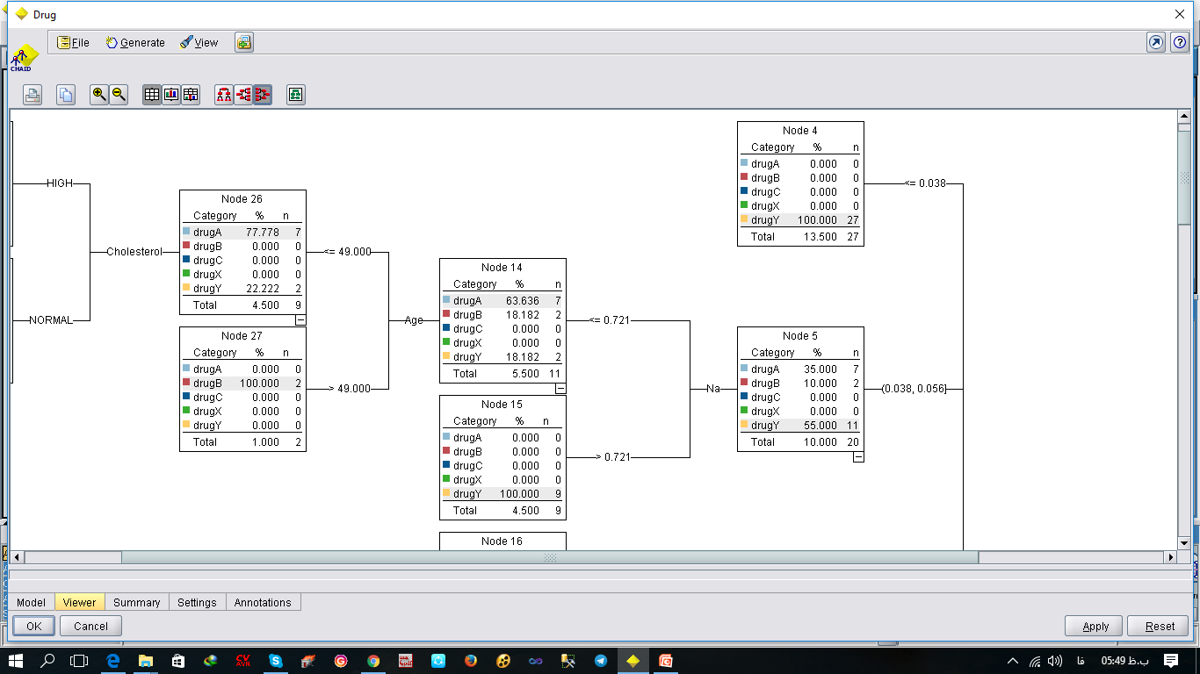
CHAID Algorithm

Slide 18
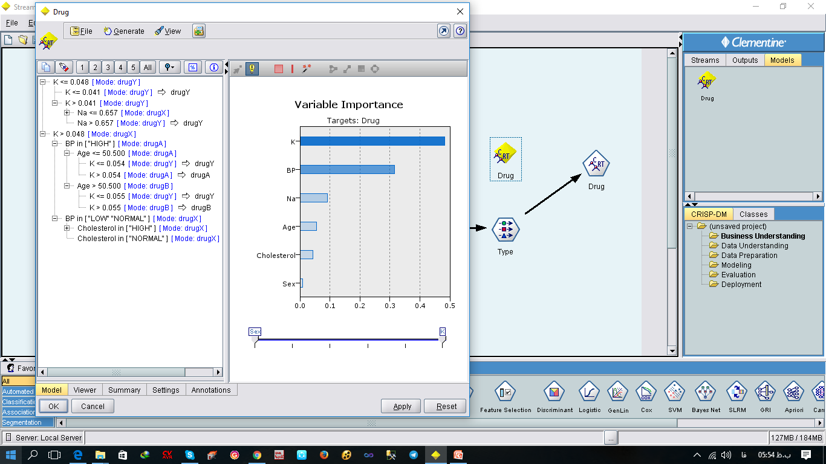
CART Algorithm

Slide 19
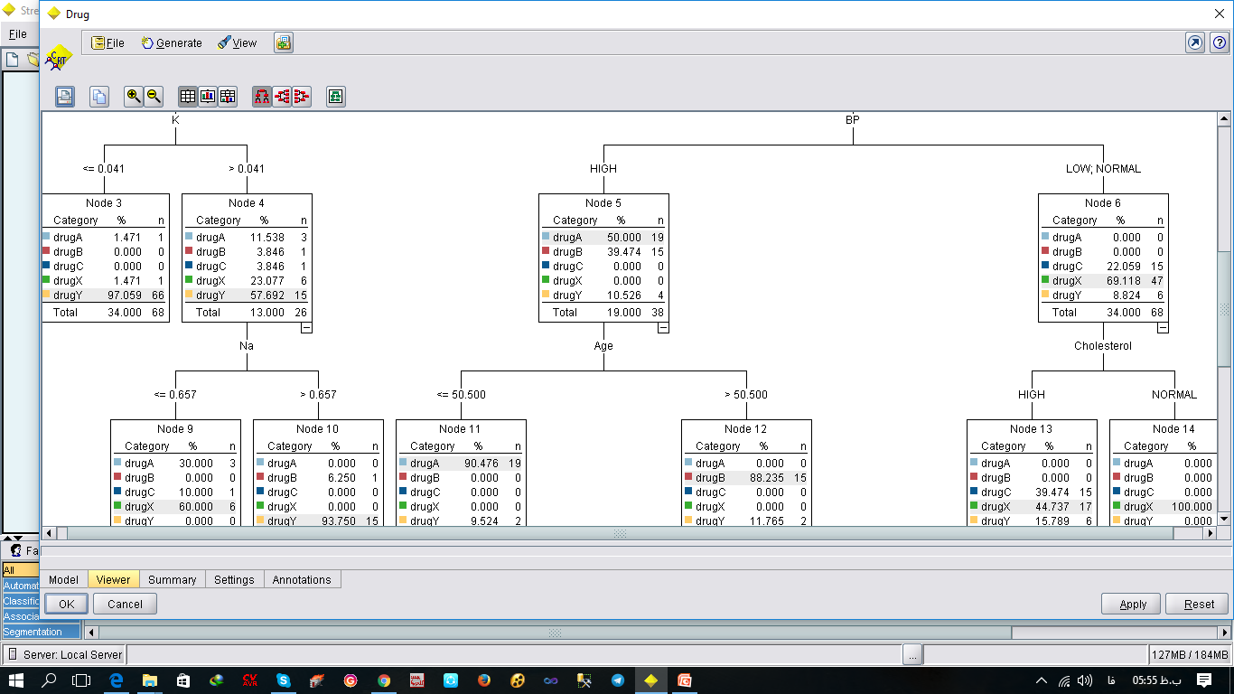
CART Algorithm

Slide 20
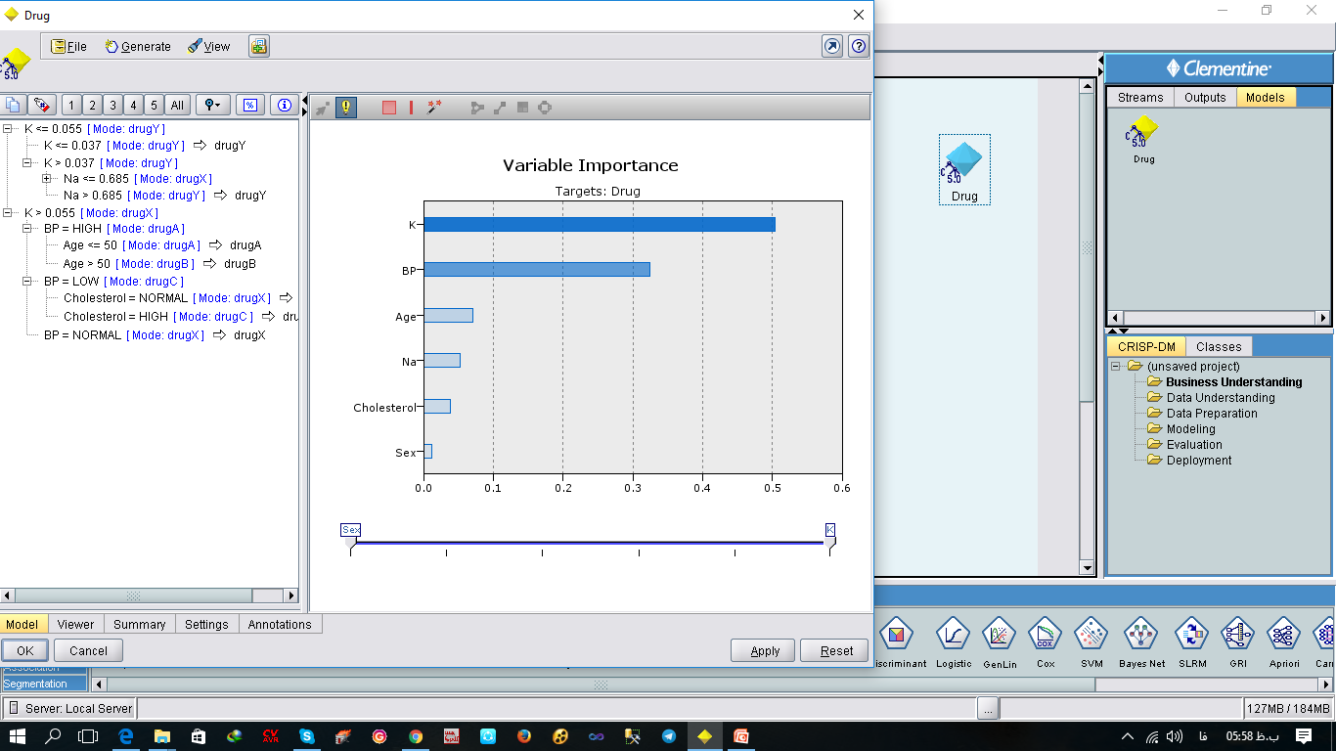
C5.0 Algorithm

Slide 21
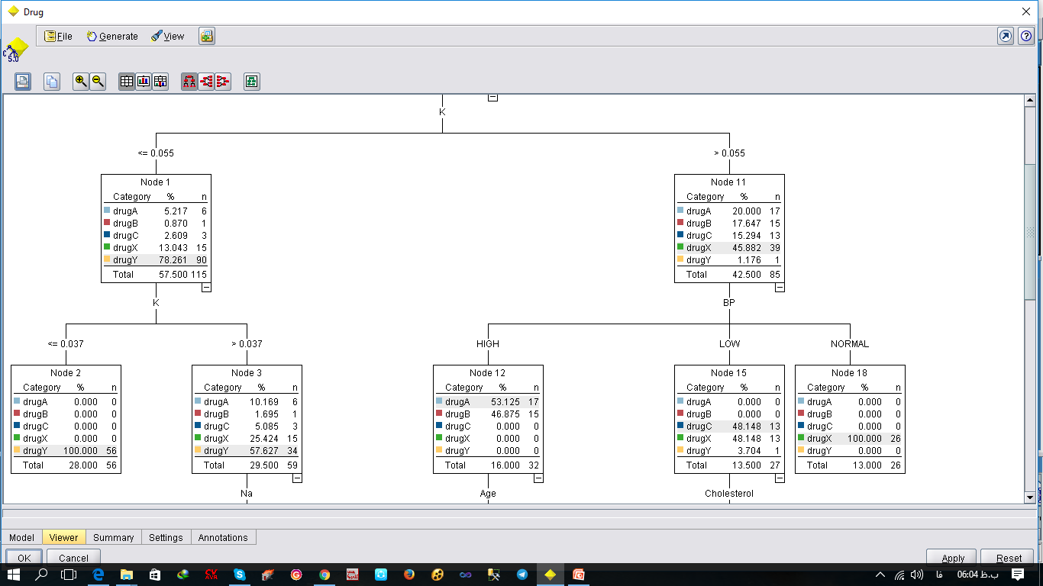
C5.0 Algorithm(Decision Tree)

Slide 22
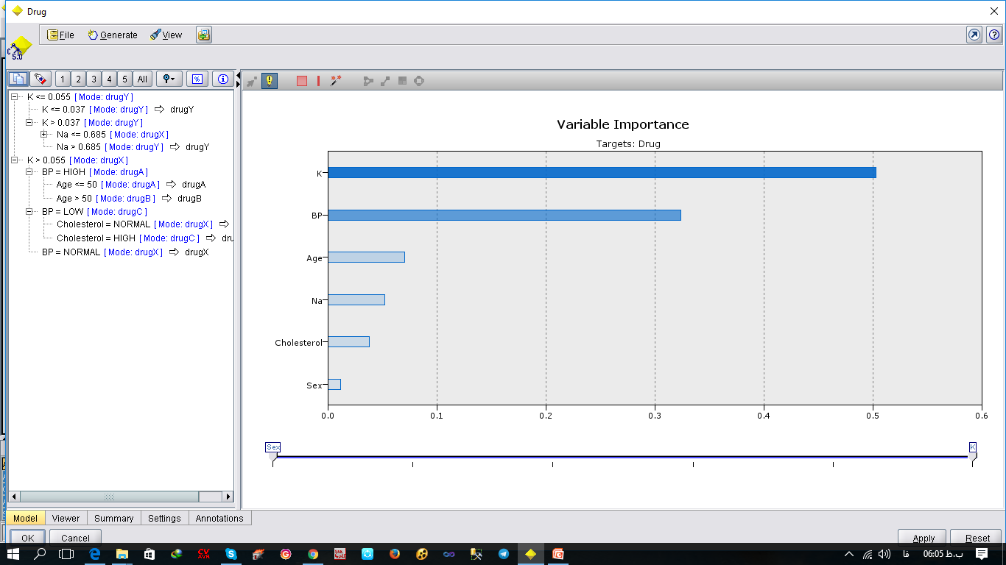
C5.0 Algorithm(Rule Set)

Slide 23


