Slide 1
Image processing toolbox
Shaghayegh jalali

Slide 2
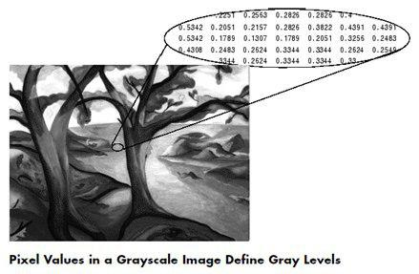
Images

Slide 3
Basic Image Import, Processing, and Export
Import, Export, and Conversion
Display and Exploration
Geometric Transformation, Spatial Referencing, and Image Registration
Image Enhancement
Image Analysis
Color
Code Generation
GPU Computing

Slide 4
Basic Image Import, Processing, and Export
Step 1: Read and Display an Image
Step 2: Check How the Image Appears in the Workspace
Step 3: Improve Image Contrast
Step 4: Write the Adjusted Image to a Disk File
Step 5: Check the Contents of the Newly Written File

Slide 5
Read and Display an Image
I = imread('pout.tif');
imshow (I)

Slide 6
Check How the Image Appears in the Workspace & Improve Image Contrast
Whos(I)
figure
imhist(I)
I2=histeq(I);
Figure
Imshow (l2)

Slide 7
comparison

Slide 8
Write the Adjusted Image to a Disk File & Check the Contents of the Newly Written File
imwrite (I2, 'pout2.png'); \\ imwrite (I2, 'C:\Users\Zahra\Desktop\pout3.png');
Imfinfo('pout2.png')

Slide 9
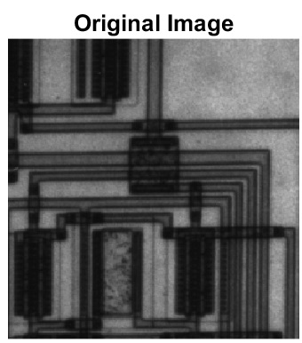
imcrop
I= imread('circuit.tif');
I2 = imcrop(I,[75 68 130 112]);
subplot(1,2,1)
imshow(I)
title('Original Image')
subplot(1,2,2)
imshow(I2)
title('Cropped Image')

Slide 10
Rotate an Image
J = imrotate(I,35,'bilinear');
imshow(I)
Figure
imshow(J)

Slide 11
rgb2gray
Convert RGB image or colormap to grayscale
RGB = imread('peppers.png');
imshow(RGB)
I= rgb2gray(RGB); figure
Imshow(I)

Slide 12
Registering an Image Using Normalized Cross-Correlation
Step 1: Read Image
Step 2: Choose Subregions of Each Image
Step 3: Do Normalized Cross-Correlation and Find Coordinates of Peak

Slide 13
Read Image

Slide 14
Choose Subregions of Each Image
rect_onion = [111 33 65 58];
rect_peppers = [163 47 143 151];
sub_onion = imcrop(onion,rect_onion);
sub_peppers = imcrop(peppers,rect_peppers);
figure, imshow(sub_onion)
figure, imshow(sub_peppers)

Slide 15
Do Normalized Cross-Correlation and Find Coordinates of Peak
c = normxcorr2(sub_onion(:,:,1),sub_peppers(:,:,1));
figure, surf(c), shading flat

Slide 16
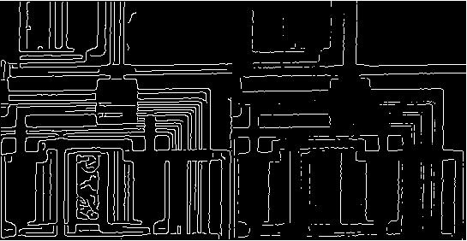
Edge
I = imread('circuit.tif'); imshow(I)
BW1 = edge(I,'Canny');
BW2 = edge(I,'Prewitt');
imshowpair(BW1,BW2,'montage')

Slide 17
Thank you

