Slide 1
مثال مولد جايگشت بازگشتي
اسلایدهای 38و 39

Slide 2
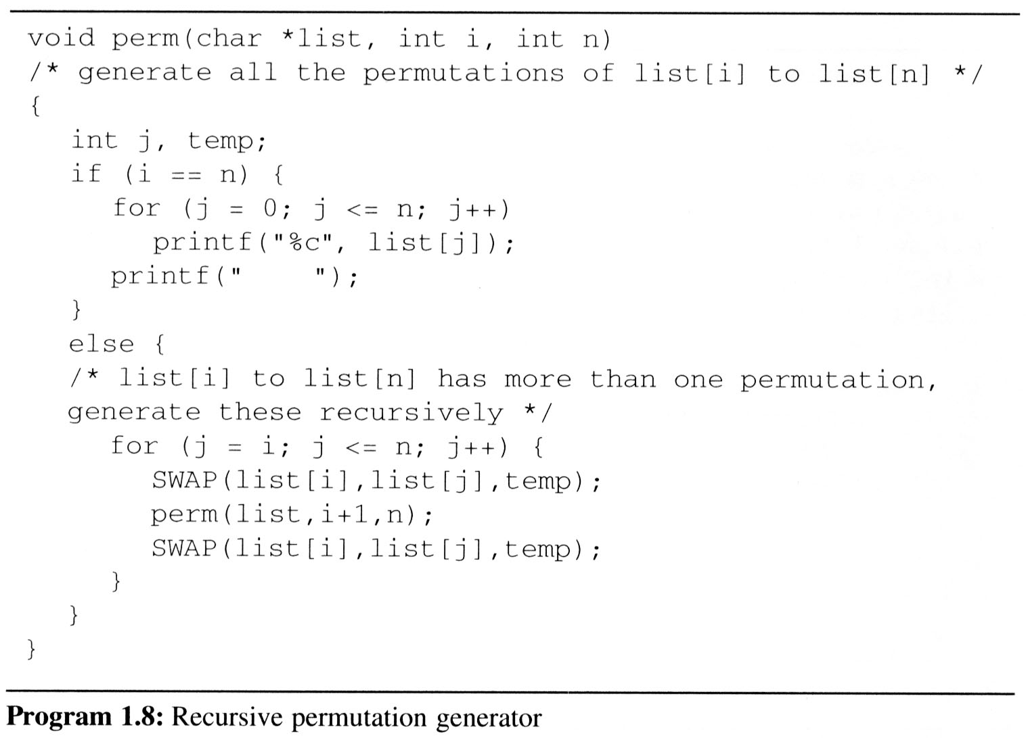
Call Stack:
مثال مولد جايگشت بازگشتي
main
First,
We Permutations the
char *string = “abc” ;
by call perm(string,0,2);
0 is start index
2 is end index
Perm ( string , 0 , 2 )
Perm ( string , 1 , 2 )
Print The String
“abc”
Print The String
“acb”
Print The String
“bac”
Print The String
“bca”
Perm ( string , 2 , 2 )
SWAP ( list[1],list[1], temp)
SWAP ‘b’ ⬄ ‘b’
SWAP ( list[1],list[1], temp)
SWAP ‘b’ ⬄ ‘b’
SWAP ( list[1],list[2], temp)
SWAP ‘b’ ⬄ ‘c’
SWAP ( list[1],list[2], temp)
SWAP ‘b’ ⬄ ‘c’
SWAP ( list[0],list[0], temp)
SWAP ‘a’ ⬄ ‘a’
SWAP ( list[0],list[1], temp)
SWAP ‘a’ ⬄ ‘b’
SWAP ( list[1],list[1], temp)
SWAP ‘b’ ⬄ ‘b’
SWAP ( list[1],list[1], temp)
SWAP ‘b’ ⬄ ‘b’
SWAP ( list[1],list[2], temp)
SWAP ‘a’ ⬄ ‘c’
SWAP ( list[1],list[2], temp)
SWAP ‘a’ ⬄ ‘c’
SWAP ( list[0],list[0], temp)
SWAP ‘a’ ⬄ ‘a’
I=0 J=0 N=2
I=1 J=1 N=2
I=1 J=1 N=2
I=1 J=2 N=2
I=1 J=2 N=2
I=0 J=0 N=2
I=0 J=1 N=2
I=1 J=3 N=2
I=1 J=1 N=2
I=1 J=1 N=2
I=1 J=2 N=2
I=1 J=2 N=2
I=1 J=3 N=2
Call : perm ( list,1, 2)
Call : perm ( list,2, 2)
Call : perm ( list,2, 2)
Call : perm ( list,2, 2)
Call : perm ( list,2, 2)
Call : perm ( list,1, 2)

Slide 3
lv0 perm: i=0, n=2 abc
lv0 SWAP: i=0, j=0 abc
lv1 perm: i=1, n=2 abc
lv1 SWAP: i=1, j=1 abc
lv2 perm: i=2, n=2 abc
print: abc
lv1 SWAP: i=1, j=1 abc
lv1 SWAP: i=1, j=2 abc
lv2 perm: i=2, n=2 acb
print: acb
lv1 SWAP: i=1, j=2 acb
lv0 SWAP: i=0, j=0 abc
lv0 SWAP: i=0, j=1 abc
lv1 perm: i=1, n=2 bac
lv1 SWAP: i=1, j=1 bac
lv2 perm: i=2, n=2 bac
print: bac
lv1 SWAP: i=1, j=1 bac
lv1 SWAP: i=1, j=2 bac
lv2 perm: i=2, n=2 bca
print: bca
lv1 SWAP: i=1, j=2 bca
lv0 SWAP: i=0, j=1 bac
lv0 SWAP: i=0, j=2 abc
lv1 perm: i=1, n=2 cba
lv1 SWAP: i=1, j=1 cba
lv2 perm: i=2, n=2 cba
print: cba
lv1 SWAP: i=1, j=1 cba
lv1 SWAP: i=1, j=2 cba
lv2 perm: i=2, n=2 cab
print: cab
lv1 SWAP: i=1, j=2 cab
lv0 SWAP: i=0, j=2 cba
مثال مولد جايگشت بازگشتي

