Slide 1
آرايه ها و ساختارها
سید مهدی وحیدی پور
اسلایدهای دارای حرکت آهسته
دانشگاه کاشان- دانشکده مهندسی برق و کامپیوتر

Slide 2
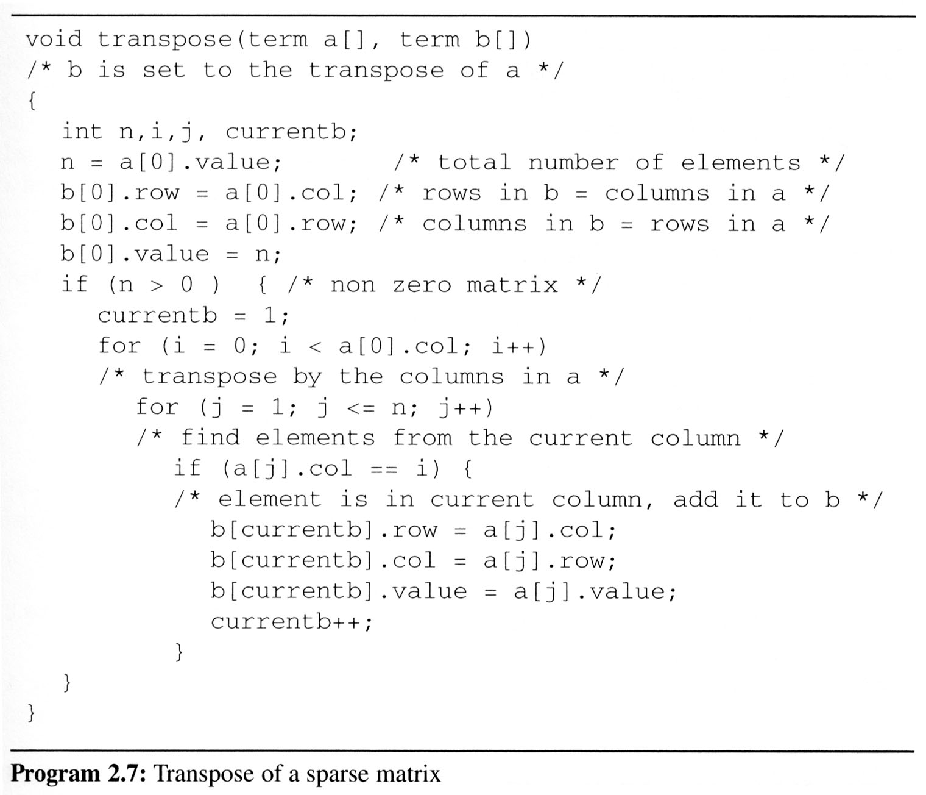
الگوريتم ترانهاده
Assign
A[i][j] to B[j][i]
place element <i, j, value> in element <j, i, value>
For all columns i
For all elements in column j
Scan the array “columns” times.
The array has “elements” elements.
==> O(columns*elements)

Slide 3
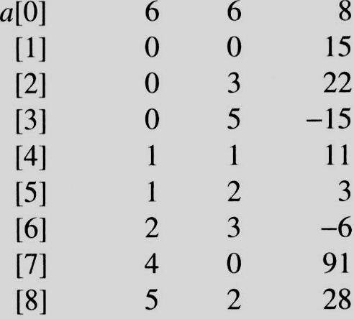
i=0 j=1
i=0 j=1
a[j]= 0 == i
i=0 j=2
i=0 j=2
a[j]=3 != i
i=0 j=3
i=0 j=3
a[j] = 5 != i
i=0 j=4
i=0 j=4
a[j].col = 1 a[j].col != i
i=0 j=5
i=0 j=5
a[j].col = 2 a[j].col != i
i=0 j=6
i=0 j=6
a[j].col = 3 != i
i=0 j=7
i=0 j=7
a[j].col = 0 == i
i=0 j=8
i=0 j=8
a[j].col = 2 != i
i=1 j=1
i=1 j=1
a[j].col = 0 != i
i=1 j=2
i=1 j=2
a[j].col = 3 != i
i=1 j=3
i=1 j=3
a[j].col = 5 != i
i=1 j=4
i=1 j=4
a[j].col = 1 == i
i=1 j=5
i=1 j=5
a[i].col = 2 != i
i=1 j=6
i=1 j=6
a[j].col = 3 != i
i=1 j=7
i=1 j=7
a[j] = 0 != i
i=1 j=8
i=1 j=8
a[i].col = 2 != i
EX: A[6][6] transpose to B[6][6]
Matrix A
Row Col Value
Set Up row & column in B[6][6]
Row Col Value
0 6 6 8
1 0 0 15
2 0 4 91
3 1 1 11
And So on…

Slide 4
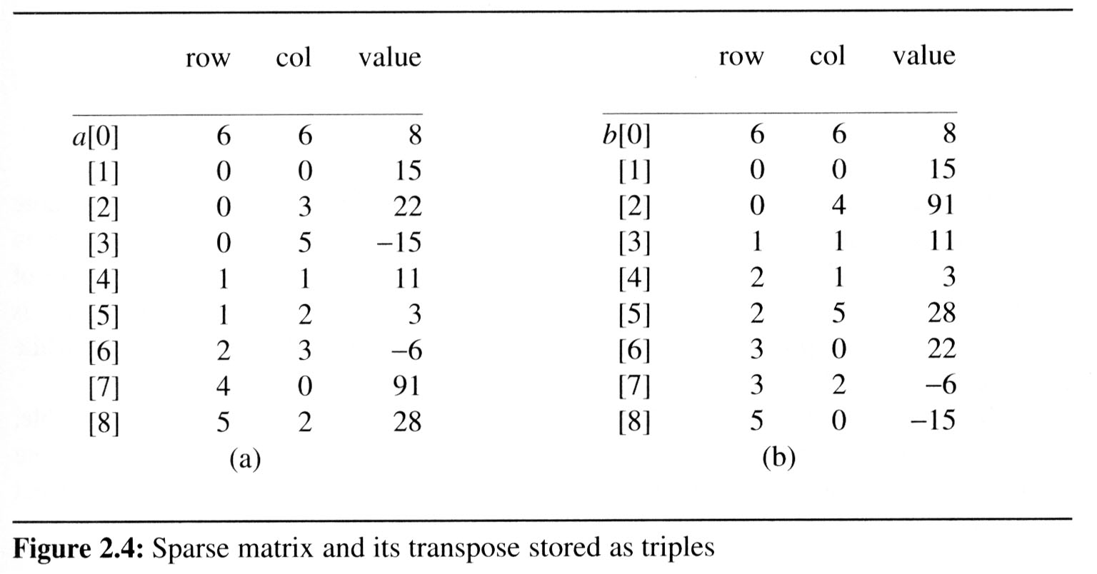
الگوريتم ترانهاده سريع
تعداد عضوهاي هر ستون ماتريس A تعداد عضوهاي هر سطرB را به دست مي دهد
Rowstart[i] برابر RowStart[i-1]+RowSize[i-1] است
[0] [1] [2] [3] [4] [5] row_terms = 2 1 2 2 0 1 starting_pos = 1 3 4 6 8 8
transpose

Slide 5
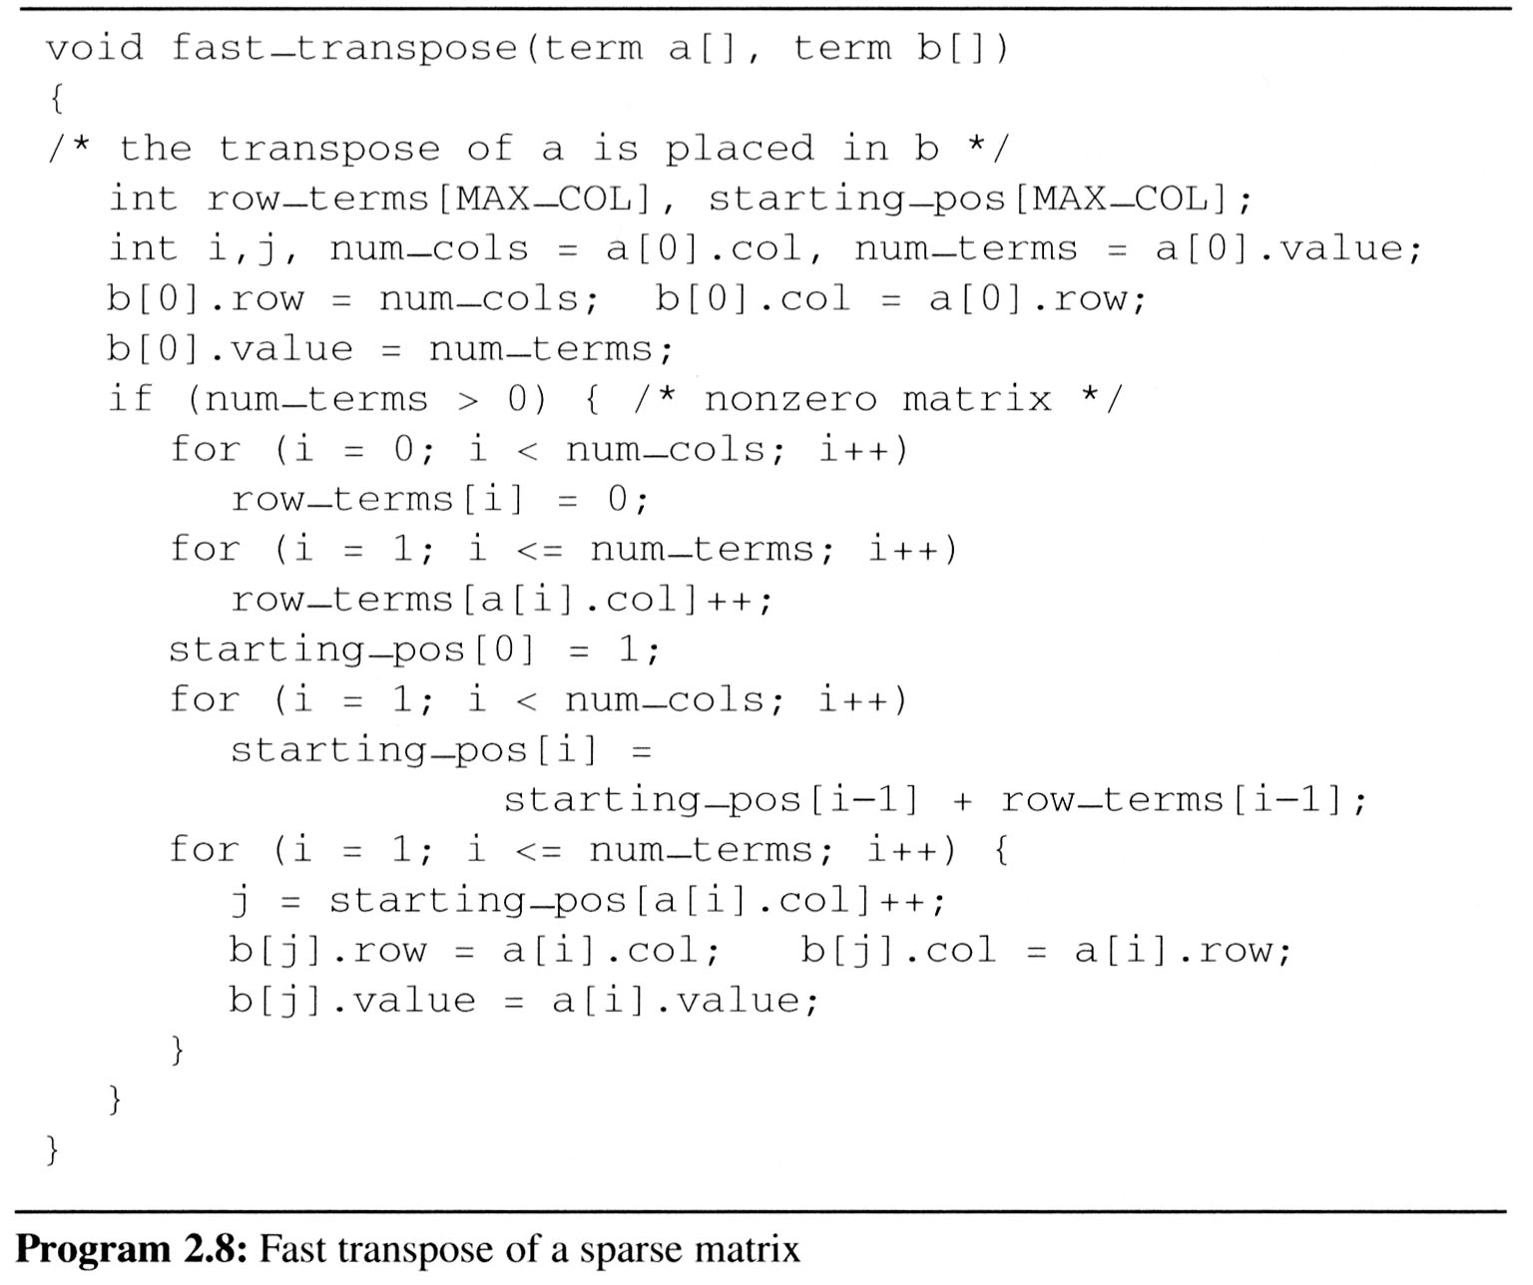
[0] [1] [2] [3] [4] [5]
row_terms
0
1
2
0
1
0
1
2
1
2
0
0
0
1
#col = 6
#term = 6
Matrix A
Row Col Value
starting_pos
1
3
4
6
8
8

Slide 6
[0] [1] [2] [3] [4] [5] row_terms = 2 1 2 2 0 1 starting_pos = 1 3 4 6 8 8
[0] [1] [2] [3] [4] [5] row_terms = 2 1 2 2 0 1 starting_pos = 2 3 4 6 8 8
[0] [1] [2] [3] [4] [5] row_terms = 2 1 2 2 0 1 starting_pos = 2 3 4 7 8 8
[0] [1] [2] [3] [4] [5] row_terms = 2 1 2 2 0 1 starting_pos = 2 3 4 7 8 9
[0] [1] [2] [3] [4] [5] row_terms = 2 1 2 2 0 1 starting_pos = 2 4 4 7 8 9
[0] [1] [2] [3] [4] [5] row_terms = 2 1 2 2 0 1 starting_pos = 2 4 5 7 8 9
[0] [1] [2] [3] [4] [5] row_terms = 2 1 2 2 0 1 starting_pos = 2 4 5 8 8 9
[0] [1] [2] [3] [4] [5] row_terms = 2 1 2 2 0 1 starting_pos = 3 4 5 8 8 9
[0] [1] [2] [3] [4] [5] row_terms = 2 1 2 2 0 1 starting_pos = 3 4 6 8 8 9
I = 1
I = 2
I = 3
I = 4
I = 5
I = 6
I = 7
I = 8
Matrix A
Row Col Value
Row Col Value
0 6 6 8
1 0 0 15
2 0 4 91
3 1 1 11
4 2 1 3
5 2 5 28
6 3 0 22
7 3 2 -6
8 5 0 -15

