Slide 1
Search Engine Optimization (SEO)

Slide 2
Why do we need SEO?
Wordpress users alone publish over 2 million posts every day!
users published around 216 blog posts
93% of online Experiences

Slide 4
process of affecting the online visibility of a website or a web page in a web search engine's unpaid results (SERP).
More Visitors
converted into customers

Slide 6
Why Google?
First website in most countries
68% of that 93% belongs to Google
First 5 Results = 67% of Clicks

Slide 7
Founded : 1998
Founders : Larry Page and Sergey Brin
Backrub
Googol (1E100 = 1 × 10100)

Slide 8
processes over 40,000 search queries every second on average
over 3.5 billion searches per day
1.2 trillion searches per year

Slide 9
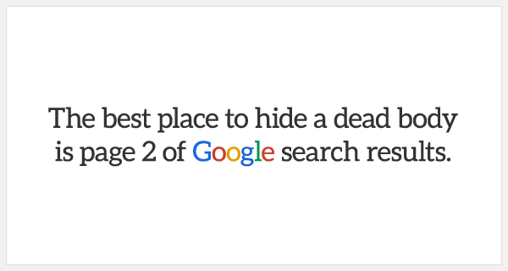

Slide 10
SEO is divided into two main parts :
On-Page SEO
Off-Page SEO

Slide 12
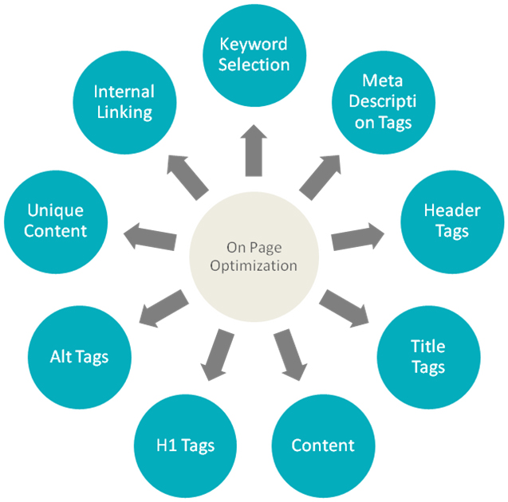
On-Page SEO

Slide 13
Meta Title & Meta Tags
<title></title>
<meta name="description" content=" ">;
<meta name=“keywords" content=" ">;

Slide 14
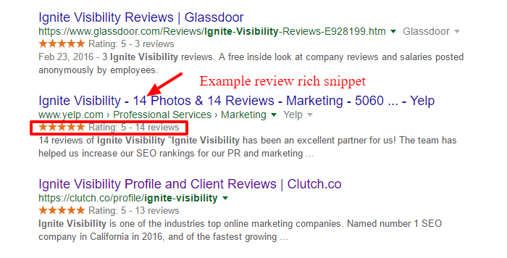
Rich Snippet
people, locations, events, product ratings/reviews, etc

Slide 15
3 myths about Google snippets
Google always uses the meta description in the snippet if it’s defined (snippets are query-specific)
Meta descriptions help with rankings (It can improve CTR)
The bolded keywords in the search listing are bolded because they affected the ranking (solely for user experience purposes)

Slide 16
On-Page SEO checklist
H1 , H2 .. , H6 Tags
Sitemap (Wordpress Plugin : All-in-one SEO Pack , Yoast SEO )
.htaccess (configuration file for use on Apache web server)
Robots.txt
Google Webmaster Tools
Image Opt. (Wordpress Plugin : SEO Friendly Images , WP Smush )
URL Friendly
Page Objects (Reducing HTTP Request) - Total Page Size
Minifying JS & CSS and Combining Them & Differing JS (Chrome Extension : Alchemize)
JS & CSS Orders
Caching (Wordpress Plugin : W3 Total Cache , WP Super Cache)

Slide 17
Coding .htaccess
WWW to non-WWW Redirection
Compressing
Expire Headers

Slide 18
WWW to non-WWW Redirection
Redirect www version to non-www version :
RewriteCond %{HTTP_HOST} ^www\.example\.com$
RewriteRule ^/?$ "http\:\/\/example\.com\/" [R=301,L]

Slide 19
Compressing
# compress text, html, javascript, css, xml:
AddOutputFilterByType DEFLATE text/plain
AddOutputFilterByType DEFLATE text/html
AddOutputFilterByType DEFLATE text/xml
AddOutputFilterByType DEFLATE text/css
AddOutputFilterByType DEFLATE application/xml
AddOutputFilterByType DEFLATE application/xhtml+xml
AddOutputFilterByType DEFLATE application/rss+xml
AddOutputFilterByType DEFLATE application/javascript
AddOutputFilterByType DEFLATE application/x-javascript

Slide 20
Expire Headers
<IfModule mod_expires.c>
ExpiresActive On
ExpiresByType image/jpg "access 1 year"
ExpiresByType image/jpeg "access 1 year"
ExpiresByType image/gif "access 1 year"
ExpiresByType image/png "access 1 year"
ExpiresByType text/css "access 1 month"
ExpiresByType application/pdf "access 1 month"
ExpiresByType text/x-javascript "access 1 month"
ExpiresByType application/x-shockwave-flash "access 1 month"
ExpiresByType image/x-icon "access 1 year"
ExpiresDefault "access plus 1 year"
</IfModule>

Slide 21
Coding Robots.txt
User-agent: *
Disallow: /admin/
Allow: / (By Default!)
Sitemap: http://example.com/sitemap.xml
Caution :
Disallow : / ➔ The Same as <meta name="robots" content="noindex">
Example :
Disallow: /folder/ Allow: /folder/myfile.html

Slide 22
Wordpress Plugins To Be Used
WP Deferred JavaScripts
JavaScript to Footer
combine JS
combine CSS
Attachment Pages Redirect
404 to 301
SEO Friendly Images
WP Smush
W3 Total Cache
All in One SEO pack

Slide 23
Google Webmaster Tools

Slide 24
Off-Page SEO
Consists of two main parts :
Link Building (important ranking factor)
Social Media

Slide 25
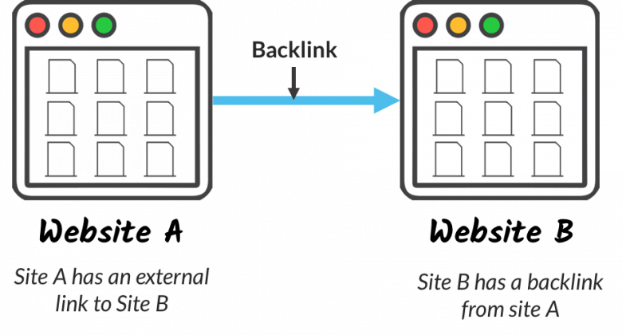
Backlink

Slide 26
Anchor Text

Slide 27
Tips & Expressions
Search engines : Crawl – Index – Rank (Based on many factors!)
Quality vs. Quantity
Outbound vs. Inbound Links
Dofolllow vs. Nofollow Links
PageRank algorithm – PA & DA
Tiered Link Building
Profile, Forum, Comment, Wiki, Guestbook, Article and …
Spammy links – Google Penalty (Algorithmic, Manual)
Negative SEO
Disavowing

Slide 28
Link Building
What Do We Need?
Windows Server (with High RAM & CPU)
Dedicated Proxys (or free ones)
Scraper (Scrape Box)
Link Building App (GSA SER + Captcha Breaker)
Monitoring App (SEO SpyGlass + Ahrefs.com)

Slide 29
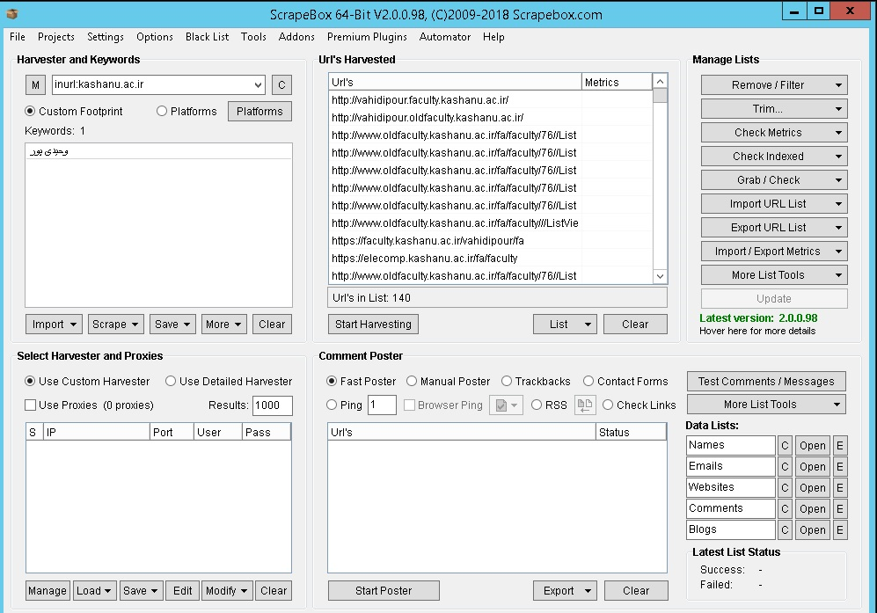

Slide 30
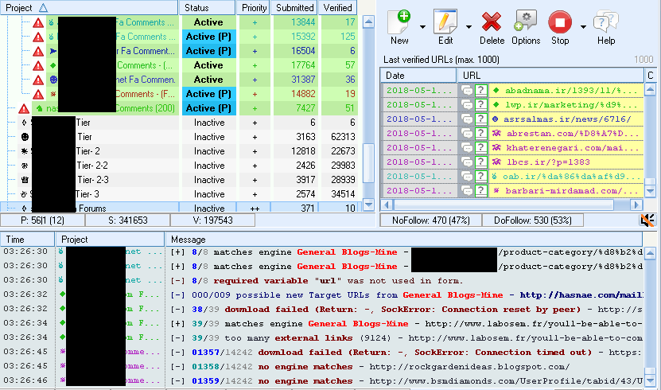

Slide 31
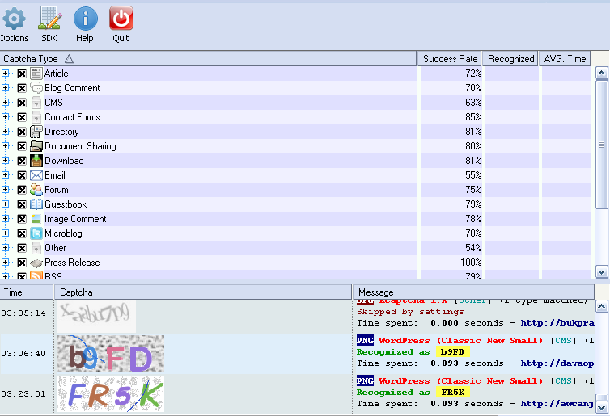

Slide 32
Spintax
{{خسته نباشید} {ممنون|مرسی} به خاطر این {مطلب|مطالب|وبسایت} {مفید|زیبا|فوق العاده|کاربردی}|سلام.وبسایت {خیلی خوب و جامعی|فوق العاده ای|جالبی|زیبایی} دارید.ممنون}

Slide 33
Thanks
Presented By : Ali Tabatabaie
Lecturer : Dr. Vahidipour

