Slide 1
Getting Started With Solr
Sahar Nafisi
Information Retrieval Presentation(Dr.Vahidipour)
Kashan University
Spring 2018

Slide 2
Before Start …!
Solr is designed to help developers to improve searching functionality in other applications.
Not used in raw form as an independent search engine.
So, there is no strong Graphical User Interface and visualization tools.
Most of operations must execute in command line and communications with search engine should be made in RESTful API context.
Solr has prepared a full set of RESTful API’s for indexing, updating, searching & … dataset.

Slide 3
Download & Run
Install JRE (Java Runtime Environment) first, to run Solr.
Download correct version for your OS from here: http://www.oracle.com/technetwork/java/javase/downloads/jre8-downloads-2133155.html
Download correct version of Solr for your OS.
https://lucene.apache.org/solr/mirrors-solr-latest-redir.html
Extract compressed file and open terminal in Solr directory and run this command:
If there was no errors, Solr is working successfully.
$ bin/solr.cmd

Slide 4
Start Solr Server
Execute this command in CMD.
Open browser and enter http://localhost:8983in URL bar.
Create Solr core with this command:
For each search engine and data set, we need to create a core.
$ bin/solr.cmd start
$ bin\solr.cmd create -c <core_name>

Slide 5
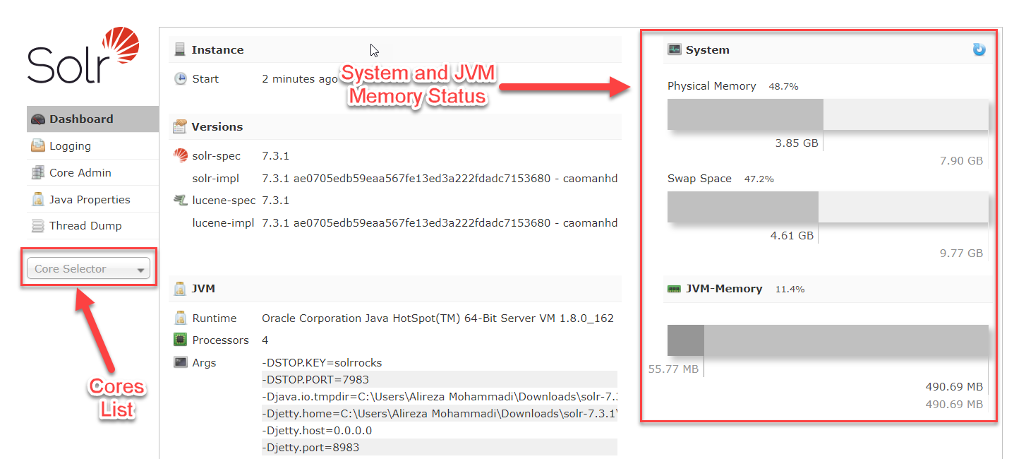
Solr Admin Panel & Core Selector

Slide 6
Some Useful Solr Commands in Terminal
$ bin\solr.cmd start -p <port_number>
Starts Solr server on another port other than default port(8983).
$ bin\solr.cmd status
Show all Solr servers running on system and memory status of them.
$ bin\solr.cmd stop -all
Stop all Solr servers running on system.
$ bin\solr.cmd stop –p <port_number>
Stop Solr server running on a specified port.

Slide 7
Modify Stop Words List
Solr has a stop words list for every language, users can view this list, and also add, edit and remove stop words from that.
To modify stop words list go to: ./server/solr/<core_name>/conf/lang/stopwords_<lang>.txt and open txt file with an editor.

Slide 8
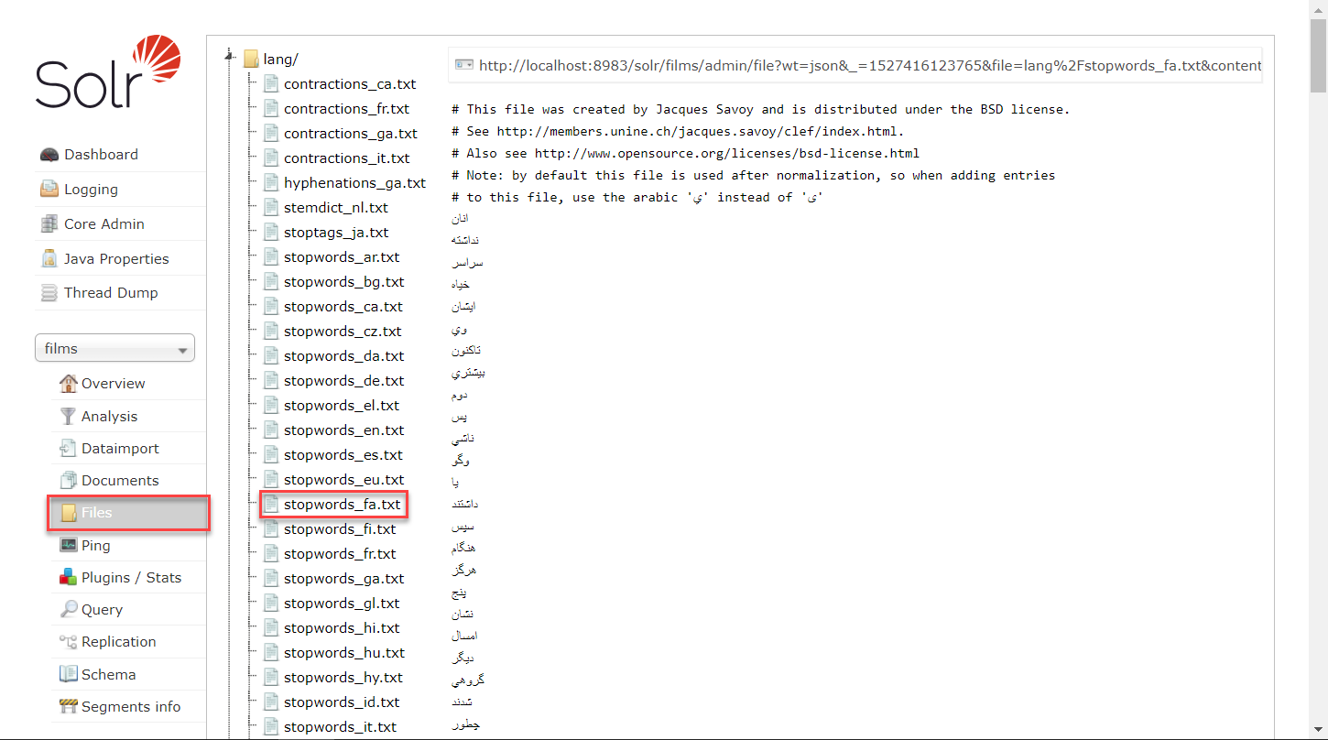
Stop Words List Screenshot

Slide 9
Import & Index Dataset (Films Dataset)
Because ‘name’ of the first film in the dataset is number ("name": ".45"), Solr considers type of ‘name’ field as number and in other rows can’t parse string to number and causes error.
To solve this problem, we must define ‘name’ field as ‘general_text’ in admin UI’s schema section.
You can define all fields of dataset with their type in schema section but if you don’t, fields generate automatically after data import.

Slide 10
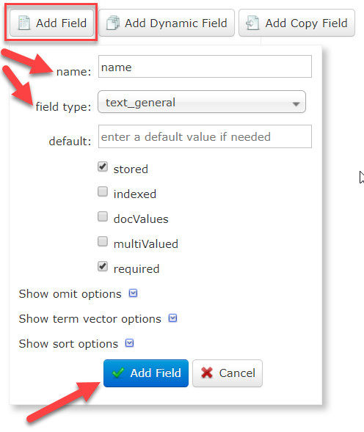
Import & Index Dataset (cont.)

Slide 11
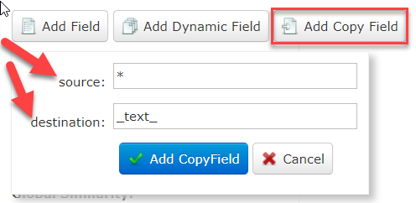
Import & Index Dataset (cont.)
We would need to define a field to search for every query. Set up a "catchall field" by defining a copy field that will take all data from all fields and index it into a field named _text_.

Slide 12
Import & Index Dataset (cont.)
To import documents from json, csv, xml & … files, execute following command in Solr directory:
java -Dc=<core_name> -jar .\example\exampledocs\post.jar -c <dataset_file(s)_path>

Slide 13
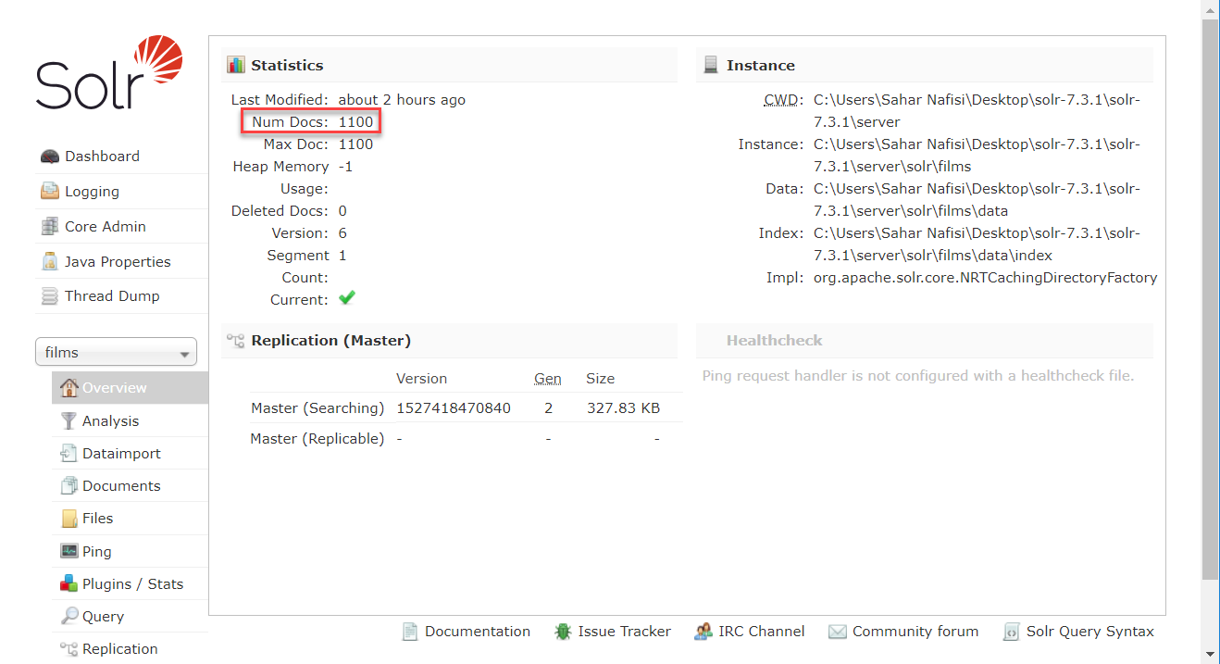
Overview of Indexed Dataset

Slide 14
Execute query
We can execute query in “query” section of solr admin.
Also we can determine the start number and number of rows in each page.

Slide 15
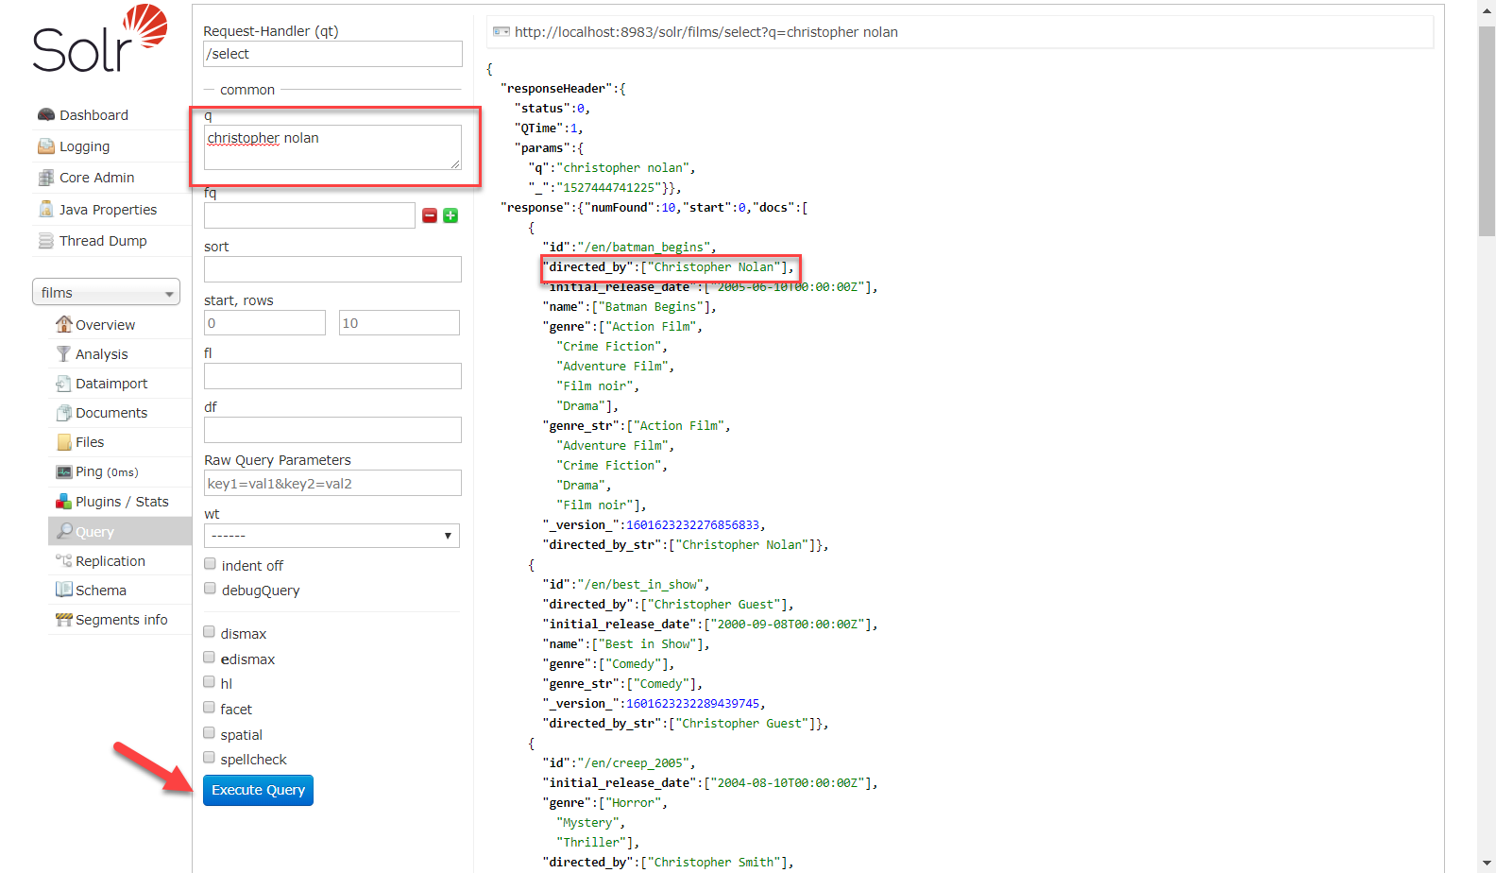
Execute query

Slide 16
Thank you ☺

