Slide 1
Data Mining:
Concepts and Techniques
(3rd ed.)
— Chapter 6 —
Jiawei Han, Micheline Kamber, and Jian Pei
University of Illinois at Urbana-Champaign &
Simon Fraser University
©2013 Han, Kamber & Pei. All rights reserved.
1
Notes:
1

Slide 2
Chapter 6: Mining Frequent Patterns, Association and Correlations: Basic Concepts and Methods
Basic Concepts
Frequent Itemset Mining Methods
Which Patterns Are Interesting?—Pattern Evaluation Methods
Summary

Slide 3
What Is Frequent Pattern Analysis?
Frequent pattern: a pattern (a set of items, subsequences, substructures, etc.) that occurs frequently in a data set
First proposed by Agrawal, Imielinski, and Swami [AIS93] in the context of frequent itemsets and association rule mining
Motivation: Finding inherent regularities in data
  What products were often purchased together?— Beer and diapers?!
  What are the subsequent purchases after buying a PC?
  What kinds of DNA are sensitive to this new drug?
  Can we automatically classify web documents?
Applications
  Basket data analysis, cross-marketing, catalog design, sale campaign analysis, Web log (click stream) analysis, and DNA sequence analysis.
Notes:
Set of Items: bread and milk
Set of subsequence: (in shopping history) First buy PC, then Digital Camera, then Memory Card.
Set of substructure: different structural form, such as subgraph, subtree, which may combined with itemsets or subsequences.
R. Agrawal et. al., Mining association rules between sets of items in large databases, 19646 citation.
inherent regularities:نظم ذاتی
The purpose of market basket analysis is to determine what products customers purchase together.
Cross- marketingبازاریابی متقابل
Sale Campaign: کمپین فروش

Slide 4
Why Is Freq. Pattern Mining Important?
Freq. pattern: An intrinsic and important property of datasets
Foundation for many essential data mining tasks
  Association, correlation, and causality analysis
  Sequential, structural (e.g., sub-graph) patterns
  Pattern analysis in spatiotemporal, multimedia, time-series, and stream data
  Classification: discriminative, frequent pattern analysis
  Cluster analysis: frequent pattern-based clustering
  Data warehousing: iceberg cube and cube-gradient
  Semantic data compression: fascicles
Notes:
Intrinsic ذاتی
Discriminative متمایز کننده

Slide 5
Basic Concepts: Frequent Patterns
Tid | Items bought
10 | Beer, Nuts, Diaper
20 | Beer, Coffee, Diaper
30 | Beer, Diaper, Eggs
40 | Nuts, Eggs, Milk
50 | Nuts, Coffee, Diaper, Eggs, Milk
itemset: A set of one or more items
k-itemset X = {x₁, …, x_{k}}
(absolute) support, or, support count of X: Frequency or occurrence of an itemset X
(relative) support, s, is the fraction of transactions that contains X (i.e., the probability that a transaction contains X)
An itemset X is frequent if X’s support is no less than a minsup threshold
Customer
buys both
Customer
buys diaper
Customer
buys beer

Slide 6
Basic Concepts: Association Rules
Tid
Items bought
Find all the rules X → Y with minimum support and confidence
  support, s, probability that a transaction contains X ∪ Y
  confidence, c, conditional probability that a transaction having X also contains Y
Let minsup = 50%, minconf = 50%
Freq. Pat.: Beer:3, Nuts:3, Diaper:4, Eggs:3, {Beer, Diaper}:3
10
Beer, Nuts, Diaper
20
Beer, Coffee, Diaper
30
Beer, Diaper, Eggs
40
Nuts, Eggs, Milk
50
Nuts, Coffee, Diaper, Eggs, Milk
Customer
buys both
Customer
buys diaper
Customer
buys beer
Association rules: (many more!)
  Beer → Diaper (60%, 100%)
  Diaper → Beer (60%, 75%)
Notes:
Confidence (A→B)=P(B|A)=Support (AUB)/Support (A)
نتیجه از رابطه بالا
Calculate Confidence → calculate Support → Min Support → Frequent Itemset
این نکته در اسلایدهای بعدی هم گفته شده

Slide 7
Closed Patterns and Max-Patterns
A long pattern contains a combinatorial number of sub-patterns, e.g., {a₁, …, a₁₀₀} contains (¹⁰⁰₁) + (¹⁰⁰₂) + … + (₁¹₀⁰₀⁰) = 2¹⁰⁰ – 1 = 1.27*10³⁰ sub-patterns!
Solution: Mine closed patterns and max-patterns instead
An itemset X is closed if X is frequent and there exists no super-pattern Y כ X, with the same support as X (proposed by Pasquier, et al. @ ICDT’99)
An itemset X is a max-pattern if X is frequent and there exists no frequent super-pattern Y כ X (proposed by Bayardo @ SIGMOD’98)
Closed pattern is a lossless compression of freq. patterns
  Reducing the # of patterns and rules

Slide 8
Closed Patterns and Max-Patterns
Exercise: Suppose a DB contains only two transactions
  <a₁, …, a₁₀₀>, <a₁, …, a₅₀>
  Let min_sup = 1
What is the set of closed itemset?
  {a₁, …, a₁₀₀}: 1
  {a₁, …, a₅₀}: 2
What is the set of max-pattern?
  {a₁, …, a₁₀₀}: 1
What is the set of all patterns?
  {a₁}: 2, …, {a₁, a₂}: 2, …, {a₁, a₅₁}: 1, …, {a₁, a₂, …, a₁₀₀}: 1
  A big number: 2¹⁰⁰ - 1? Why?
Notes:
2^{100} – 1 because every k-itemset (pattern) for k = 1, ..,100 is frequent with support either 1 or 2.

Slide 9
Chapter 5: Mining Frequent Patterns, Association and Correlations: Basic Concepts and Methods
Basic Concepts
Frequent Itemset Mining Methods
Which Patterns Are Interesting?—Pattern Evaluation Methods
Summary

Slide 10
Association Rule Mining Task
Given a set of transactions T, the goal of association rule mining is to find all rules having
  support ≥ minsup threshold
  confidence ≥ minconf threshold
Brute-force approach:
  List all possible association rules
  Compute the support and confidence for each rule
  Prune rules that fail the minsup and minconf thresholds
  ⇒ Computationally prohibitive!
Notes:
Prohibitive فوق العاده ---- جلوگیری کننده

Slide 11
Mining Association Rules
Example of Rules:
{Milk,Diaper} → {Beer} (s=0.4, c=0.67)
{Milk,Beer} → {Diaper} (s=0.4, c=1.0)
{Diaper,Beer} → {Milk} (s=0.4, c=0.67)
{Beer} → {Milk,Diaper} (s=0.4, c=0.67)
{Diaper} → {Milk,Beer} (s=0.4, c=0.5)
{Milk} → {Diaper,Beer} (s=0.4, c=0.5)
Observations:
All the above rules are binary partitions of the same itemset:
{Milk, Diaper, Beer}
Rules originating from the same itemset have identical support but
can have different confidence
Thus, we may decouple the support and confidence requirements
Notes:
decouple جدا کردن

Slide 12
Mining Association Rules
Two-step approach:
  Frequent Itemset Generation
    Generate all itemsets whose support ≥ minsup
  Rule Generation
    Generate high confidence rules from each frequent itemset, where each rule is a binary partitioning of a frequent itemset
Frequent itemset generation is still computationally expensive

Slide 13
Frequent Itemset Generation
Given d items, there are 2^{d} possible candidate itemsets

Slide 14
Frequent Itemset Generation
Brute-force approach:
  Each itemset in the lattice is a candidate frequent itemset
  Count the support of each candidate by scanning the database
  Match each transaction against every candidate
  Complexity ~ O(NMw) => Expensive since M = 2^{d} !!!

Slide 15
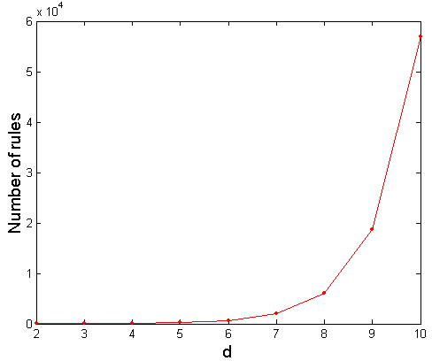
Computational Complexity
Given d unique items:
  Total number of itemsets = 2^{d}
  Total number of possible association rules:
If d=6, R = 602 rules
Notes:
R=تعداد قوانین انجمنی

Slide 16
Frequent Itemset Generation Strategies
Reduce the number of candidates (M)
  Complete search: M=2^{d}
  Use pruning techniques to reduce M
Reduce the number of transactions (N)
  Reduce size of N as the size of itemset increases
  Used by DHP and vertical-based mining algorithms
Reduce the number of comparisons (NM)
  Use efficient data structures to store the candidates or transactions
  No need to match every candidate against every transaction
Notes:
DHP: Reduce the Number of Candidates

Slide 17
Scalable Frequent Itemset Mining Methods
Apriori: A Candidate Generation-and-Test Approach
Improving the Efficiency of Apriori
FPGrowth: A Frequent Pattern-Growth Approach
ECLAT: Frequent Pattern Mining with Vertical Data Format

Slide 18
The Downward Closure Property and Scalable Mining Methods
Scalable mining methods: Three major approaches
  Apriori (Agrawal & Srikant@VLDB’94)
  Freq. pattern growth (FPgrowth—Han, Pei & Yin @SIGMOD’00)
  Vertical data format approach (Charm—Zaki & Hsiao @SDM’02)
The downward closure property of frequent patterns
  Any subset of a frequent itemset must be frequent
  If {beer, diaper, nuts} is frequent, so is {beer, diaper}
  i.e., every transaction having {beer, diaper, nuts} also contains {beer, diaper}

Slide 19
Illustrating Apriori Principle
Found to be Infrequent
Pruned supersets

Slide 20
Apriori: A Candidate Generation & Test Approach
Apriori pruning principle: If there is any itemset which is infrequent, its superset should not be generated/tested! (Agrawal & Srikant @VLDB’94, Mannila, et al. @ KDD’ 94)
Method:
  Initially, scan DB once to get frequent 1-itemset
  Generate length (k+1) candidate itemsets from length k frequent itemsets
  Test the candidates against DB
  Terminate when no frequent or candidate set can be generated

Slide 21
The Apriori Algorithm—An Example
Sup_{min} = 2
Itemset | sup
{A} | 2
{B} | 3
{C} | 3
{D} | 1
{E} | 3
Database TDB
Itemset | sup
{A} | 2
{B} | 3
{C} | 3
{E} | 3
L₁
Tid | Items
10 | A, C, D
20 | B, C, E
30 | A, B, C, E
40 | B, E
C₁
1st scan
C₂
Itemset | sup
{A, B} | 1
{A, C} | 2
{A, E} | 1
{B, C} | 2
{B, E} | 3
{C, E} | 2
C₂
Itemset
{A, B}
{A, C}
{A, E}
{B, C}
{B, E}
{C, E}
L₂
Itemset | sup
{A, C} | 2
{B, C} | 2
{B, E} | 3
{C, E} | 2
2nd scan
C₃
Itemset
{B, C, E}
3rd scan
L₃
Itemset | sup
{B, C, E} | 2

Slide 22
The Apriori Algorithm (Pseudo-Code)
C_{k}: Candidate itemset of size k
L_{k} : frequent itemset of size k
L₁ = {frequent items};
for (k = 1; L_{k} !=∅; k++) do begin
C_{k+1} = candidates generated from L_{k};
for each transaction t in database do
  increment the count of all candidates in C_{k+1} that are contained in t
L_{k+1} = candidates in C_{k+1} with minsup
end
return ∪_{k} L_{k};
Notes:
P. 290: Psuedo

Slide 23
Implementation of Apriori
How to generate candidates?
  Step 1: self-joining L_{k}
  Step 2: pruning
Example of Candidate-generation
  L₃={abc, abd, acd, ace, bcd}
  Self-joining: L₃*L₃
    abcd from abc and abd
    acde from acd and ace
  Pruning:
    acde is removed because ade is not in L₃
  C₄ = {abcd}

Slide 24
How to Count Supports of Candidates?
Why counting supports of candidates a problem?
  The total number of candidates can be very huge
  One transaction may contain many candidates
Method:
  Candidate itemsets are stored in a hash-tree
  Leaf node of hash-tree contains a list of itemsets and counts
  Interior node contains a hash table
  Subset function: finds all the candidates contained in a transaction

Slide 25
Counting Supports of Candidates Using Hash Tree
Subset function
Transaction: 1 2 3 5 6
3,6,9
1,4,7
2,5,8
1 + 2 3 5 6
1 3 + 5 6
2 3 4
5 6 7
1 4 5
3 4 5
3 5 6
3 5 7
6 8 9
3 6 7
3 6 8
1 3 6
1 2 + 3 5 6
1 2 4
4 5 7
1 2 5
4 5 8
1 5 9

Slide 26
Candidate Generation: An SQL Implementation
SQL Implementation of candidate generation
  Suppose the items in L_{k-1} are listed in an order
  Step 1: self-joining L_{k-1}
    insert into C_{k}
    select p.item₁, p.item₂, …, p.item_{k-1}, q.item_{k-1}
    from L_{k-1} p, L_{k-1} q
    where p.item₁=q.item₁, …, p.item_{k-2}=q.item_{k-2}, p.item_{k-1} < q.item_{k-1}
  Step 2: pruning
    forall itemsets c in C_{k} do
      forall (k-1)-subsets s of c do
        if (s is not in L_{k-1}) then delete c from C_{k}
Use object-relational extensions like UDFs, BLOBs, and Table functions for efficient implementation [S. Sarawagi, S. Thomas, and R. Agrawal. Integrating association rule mining with relational database systems: Alternatives and implications. SIGMOD’98]

Slide 27
Scalable Frequent Itemset Mining Methods
27
Apriori: A Candidate Generation-and-Test Approach
Improving the Efficiency of Apriori
FPGrowth: A Frequent Pattern-Growth Approach
ECLAT: Frequent Pattern Mining with Vertical Data Format
Mining Close Frequent Patterns and Maxpatterns
Notes:
27

Slide 28
Further Improvement of the Apriori Method
Major computational challenges
  Multiple scans of transaction database
  Huge number of candidates
  Tedious workload of support counting for candidates
Improving Apriori: general ideas
  Reduce passes of transaction database scans
  Shrink number of candidates
  Facilitate support counting of candidates

Slide 29
Reducing Number of Comparisons
Candidate counting:
  Scan the database of transactions to determine the support of each candidate itemset
  To reduce the number of comparisons, store the candidates in a hash structure
    Instead of matching each transaction against every candidate, match it against candidates contained in the hashed buckets

Slide 30
How to Count Supports of Candidates?
Why counting supports of candidates a problem?
  The total number of candidates can be very huge
  One transaction may contain many candidates
Method:
  Candidate itemsets are stored in a hash-tree
  Leaf node of hash-tree contains a list of itemsets and counts
  Interior node contains a hash table
  Subset function: finds all the candidates contained in a transaction

Slide 31
Generate Hash Tree
Suppose you have 15 candidate itemsets of length 3:
{1 4 5}, {1 2 4}, {4 5 7}, {1 2 5}, {4 5 8}, {1 5 9}, {1 3 6}, {2 3 4}, {5 6 7}, {3 4 5}, {3 5 6}, {3 5 7}, {6 8 9}, {3 6 7}, {3 6 8}
You need:
Hash function
Max leaf size: max number of itemsets stored in a leaf node (if number of candidate itemsets exceeds max leaf size, split the node)
Hash function
2 3 4
5 6 7
3,6,9
1,4,7
1 4 5
3 4 5
3 5 6
3 5 7
6 8 9
3 6 7
3 6 8
1 3 6
2,5,8
1 2 4
4 5 7
1 2 5
4 5 8
1 5 9

Slide 32
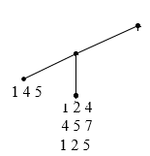
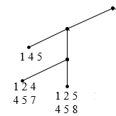
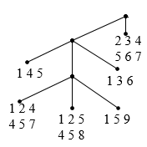
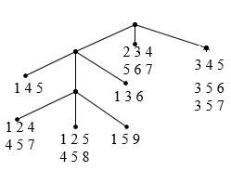
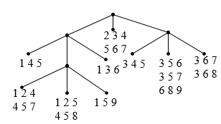
Generate Hash Tree
{1 4 5}, {1 2 4}, {4 5 7}, {1 2 5}, {4 5 8}, {1 5 9}, {1 3 6}, {2 3 4}, {5 6 7}, {3 4 5}, {3 5 6}, {3 5 7}, {6 8 9}, {3 6 7}, {3 6 8}
1 5 9
1 3 6
2 3 4
5 6 7
1 4 5
1 2 4
4 5 7
1 2 5
4 5 8
3 4 5
3 5 6
3 5 7
6 8 9
3 6 7
3 6 8
Hash function
1,4,7
3,6,9
2,5,8

Slide 33
Association Rule Discovery: Hash tree
Hash Function
Candidate Hash Tree
1,4,7
3,6,9
2,5,8
2 3 4
5 6 7
1 4 5
1 3 6
3 4 5
3 5 6
3 6 7
Hash on 1, 4 or 7
3 5 7
3 6 8
1 2 4
1 5 9
6 8 9
1 2 5
4 5 7
4 5 8

Slide 34
Association Rule Discovery: Hash tree
Hash Function
Candidate Hash Tree
1,4,7
3,6,9
2,5,8
2 3 4
5 6 7
1 4 5
1 3 6
3 4 5
3 5 6
3 6 7
Hash on 2, 5 or 8
3 5 7
3 6 8
1 2 4
1 5 9
6 8 9
1 2 5
4 5 7
4 5 8

Slide 35
Association Rule Discovery: Hash tree
Hash Function
Candidate Hash Tree
1,4,7
3,6,9
2,5,8
2 3 4
5 6 7
1 4 5
1 3 6
3 4 5
3 5 6
3 6 7
Hash on 3, 6 or 9
3 5 7
3 6 8
1 2 4
1 5 9
6 8 9
1 2 5
4 5 7
4 5 8

Slide 36
Subset Operation
Given a transaction t, what are the possible subsets of size 3?

Slide 37
Subset Operation Using Hash Tree
1 2 3 5 6
transaction
Hash Function
1 +
2 3 5 6
2 +
3 5 6
1,4,7
3,6,9
3 +
5 6
2,5,8
2 3 4
5 6 7
1 4 5
1 3 6
3 4 5
3 5 6
3 6 7
3 5 7
3 6 8
1 2 4
1 2 5
1 5 9
6 8 9
4 5 7
4 5 8

Slide 38
Subset Operation Using Hash Tree
1 2 3 5 6
transaction
Hash Function
1 +
2 3 5 6
2 +
3 5 6
1,4,7
3,6,9
1 2 +
3 5 6
3 +
5 6
2,5,8
1 3 +
5 6
2 3 4
1 5 +
6
5 6 7
1 4 5
1 3 6
3 4 5
3 5 6
3 6 7
3 5 7
3 6 8
1 2 4
1 2 5
1 5 9
6 8 9
4 5 7
4 5 8

Slide 39
Subset Operation Using Hash Tree
1 2 3 5 6
transaction
Hash Function
1 +
2 3 5 6
2 +
3 5 6
1,4,7
3,6,9
1 2 +
3 5 6
3 +
5 6
2,5,8
1 3 +
5 6
2 3 4
1 5 +
6
5 6 7
1 4 5
1 3 6
3 4 5
3 5 6
3 6 7
3 5 7
3 6 8
1 2 4
1 2 5
1 5 9
6 8 9
4 5 7
4 5 8
Match transaction against 11 out of 15 candidates

Slide 40
Improving the Efficiency of Apriori
Other Methods
  Partition: Scan Database Only Twice
    A. Savasere, E. Omiecinski and S. Navathe, VLDB’95
  DHP: Reduce the Number of Candidates
    DHP: Direct Hashing and Pruning
    J. Park, M. Chen, and P. Yu. An effective hash-based algorithm for mining association rules. SIGMOD’95
  DIC: Reduce Number of Scans
    DIC: Dynamic itemset counting
    H. Toivonen. Sampling large databases for association rules. In VLDB’96

Slide 41
Partition: Scan Database Only Twice
Any itemset that is potentially frequent in DB must be frequent in at least one of the partitions of DB
  Scan 1: partition database and find local frequent patterns
  Scan 2: consolidate global frequent patterns
A. Savasere, E. Omiecinski and S. Navathe, VLDB’95
DB₁
+
DB₂
+
+
DB_{k}
= DB
sup₁(i) < σDB₁
sup₂(i) < σDB₂
sup_{k}(i) < σDB_{k}
sup(i) < σDB

Slide 42
DHP: Reduce the Number of Candidates
A k-itemset whose corresponding hashing bucket count is below the threshold cannot be frequent
  Candidates: a, b, c, d, e
  Hash entries
    {ab, ad, ae}
    {bd, be, de}
    …
  Frequent 1-itemset: a, b, d, e
  ab is not a candidate 2-itemset if the sum of count of {ab, ad, ae} is below support threshold
J. Park, M. Chen, and P. Yu. An effective hash-based algorithm for mining association rules. SIGMOD’95
count
itemsets
35
{ab, ad, ae}
88
{bd, be, de}
...
...
102
{yz, qs, wt}
Hash Table

Slide 43
Sampling for Frequent Patterns
Select a sample of original database, mine frequent patterns within sample using Apriori
Scan database once to verify frequent itemsets found in sample, only borders of closure of frequent patterns are checked
  Example: check abcd instead of ab, ac, …, etc.
Scan database again to find missed frequent patterns
H. Toivonen. Sampling large databases for association rules. In VLDB’96

Slide 44
DIC: Reduce Number of Scans
ABCD
Once both A and D are determined frequent, the counting of AD begins
Once all length-2 subsets of BCD are determined frequent, the counting of BCD begins
ABC
ABD
ACD
BCD
AB
AC
BC
AD
BD
CD
Transactions
1-itemsets
A
B
C
D
Apriori
2-itemsets
…
{}
Itemset lattice
1-itemsets
S. Brin R. Motwani, J. Ullman, and S. Tsur. Dynamic itemset counting and implication rules for market basket data. In SIGMOD’97
2-items
DIC
3-items

Slide 45
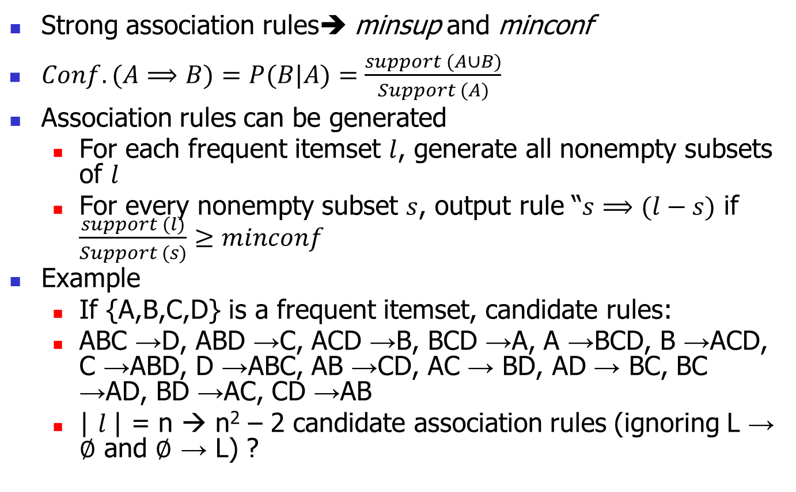
Rule Generation from Frequent Itemsets
Strong association rules➔ minsup and minconf
$Conf. (A⟹B)=P(B|A)=\frac{support (A∪B)}{Support (A)}$
Association rules can be generated
  For each frequent itemset $l$, generate all nonempty subsets of $l$
  For every nonempty subset $s$, output rule “$s⟹(l−s)$ if $\frac{support (l)}{Support (s)}≥minconf$
Example
  If {A,B,C,D} is a frequent itemset, candidate rules:
  ABC →D, ABD →C, ACD →B, BCD →A, A →BCD, B →ACD, C →ABD, D →ABC, AB →CD, AC → BD, AD → BC, BC →AD, BD →AC, CD →AB
  | $l$| = n → n² – 2 candidate association rules (ignoring L → ∅ and ∅ → L) ?

Slide 46
Rule Generation from Frequent Itemsets
How to efficiently generate rules from frequent itemsets?
  In general, confidence does not have an antimonotone property
    conf(ABC →D) can be larger or smaller than conf(AB →D)
  But confidence of rules generated from the same itemset has an anti-monotone property
    e.g., L = {A,B,C,D}:
    conf(ABC → D) ≥ conf(AB → CD) ≥ conf(A → BCD)

Slide 47
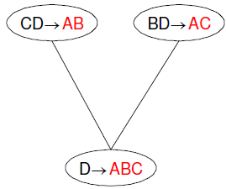
Rule Generation
Candidate rule is generated by merging two rules that share the same prefix in the rule consequent
  join(CD → AB, BD → AC) would produce the candidate rule D → ABC
  Prune rule D → ABC if its subset AD → BC does not have high confidence

Slide 48
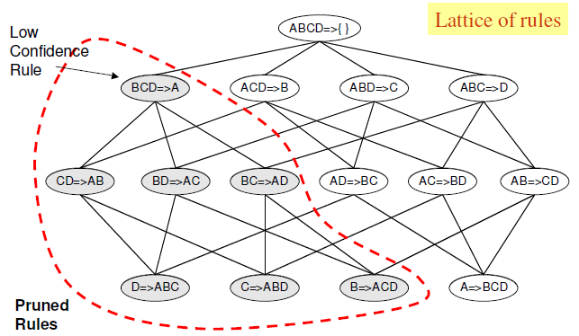
Rule Pruning

Slide 49
Rule Generation Algorithm
Moving items from the antecedent to the consequent never changes support, and never increases confidence
Homework #1
Dead time: 96/08/09
Email: Vahidipour@kashanu.ac.ir

Slide 50
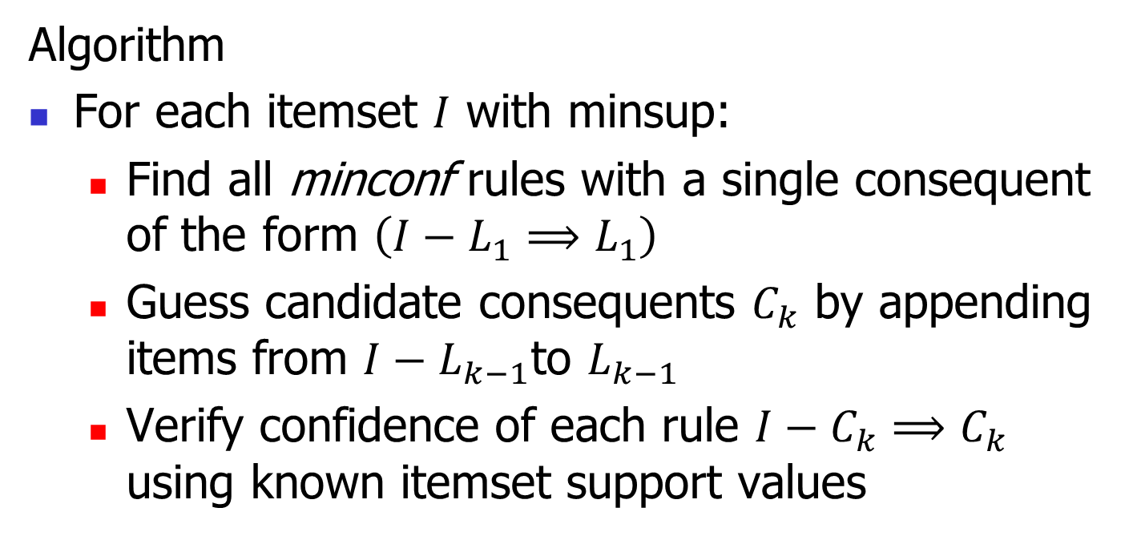
Rule Generation Algorithm
Moving items from the antecedent to the consequent never changes support, and never increases confidence
Algorithm
For each itemset $I$ with minsup:
  Find all minconf rules with a single consequent of the form $\left(I−L_{1}⟹L_{1}\right)$
  Guess candidate consequents $C_{k}$ by appending items from $I−L_{k−1}$to $L_{k−1}$
  Verify confidence of each rule $I−C_{k}{⟹C}_{k}$ using known itemset support values
repeat

Slide 51
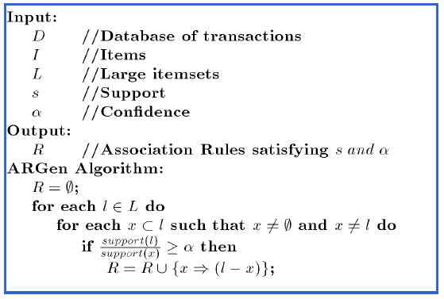
Algorithm to Generate Association Rules

Slide 52
Scalable Frequent Itemset Mining Methods
52
Projects for Students
  FPGrowth: A Frequent Pattern-Growth Approach
  ECLAT: Frequent Pattern Mining with Vertical Data Format
  Mining Close Frequent Patterns and Maxpatterns
Notes:
52

Slide 53
Chapter 5: Mining Frequent Patterns, Association and Correlations: Basic Concepts and Methods
Basic Concepts
Frequent Itemset Mining Methods
Which Patterns Are Interesting?—Pattern Evaluation Methods
Summary

Slide 54
Interestingness Measure: Correlations (Lift)
play basketball ⇒ eat cereal [40%, 66.7%] is misleading
  The overall % of students eating cereal is 75% > 66.7%.
play basketball ⇒ not eat cereal [20%, 33.3%] is more accurate, although with lower support and confidence
Measure of dependent/correlated events: lift
 | Basketball | Not basketball | Sum (row)
Cereal | 2000 | 1750 | 3750
Not cereal | 1000 | 250 | 1250
Sum(col.) | 3000 | 2000 | 5000
Contingency Table
Notes:
Contingency Table: جدول حدوث
در برخي از مواقع ممکن است الگوهايي با تکرار کم نيز براي کاربر سودمند باشند.
معیارها دو دسته اند: objective , Subjective
Objective:به داده مربوط است مثل ساپورت و کانفیدنس
Subjective: به فرد و حوزه کار مربوط است
در حالت اول بین دو مورد همبستگی منفی وجود دارد افزایش یکی باعث کاهش دیگری است

Slide 55
Interestingness Measure: Correlations (Lift)
 | Basketball | Not basketball | Sum (row)
Cereal | 2000 | 1750 | 3750
Not cereal | 1000 | 250 | 1250
Sum(col.) | 3000 | 2000 | 5000
Notes:
Contingency Table: جدول حدوث
در برخي از مواقع ممکن است الگوهايي با تکرار کم نيز براي کاربر سودمند باشند.
معیارها دو دسته اند: objective , Subjective
Objective:به داده مربوط است مثل ساپورت و کانفیدنس
Subjective: به فرد و حوزه کار مربوط است
در حالت اول بین دو مورد همبستگی منفی وجود دارد افزایش یکی باعث کاهش دیگری است

Slide 56
Text mining: lift or confidence?
Two pair of words: {P, Q}, {R,S}
 | P | No P | Sum (row)
Q | 880 | 50 | 930
No Q | 50 | 20 | 70
Sum(col.) | 930 | 70 | 1000
 | R | No R | Sum (row)
S | 20 | 50 | 70
No S | 50 | 880 | 930
Sum(col.) | 70 | 930 | 1000
Notes:
آمدن دو واژه با همدیگر
پی و کیو در 88 درصد داکیومنتها هستند
آر و اس به ندرت در کنار هم هستند (2 درصد) اما لیفت بالایی دارند.
معیار کانفیدنس بهتر است

Slide 57
MEASURMENTS
Support and confidence are not good to indicate correlations
Over 20 interestingness measures have been proposed (see Tan, Kumar, Sritastava @KDD’02)
Which are good ones?

Slide 58
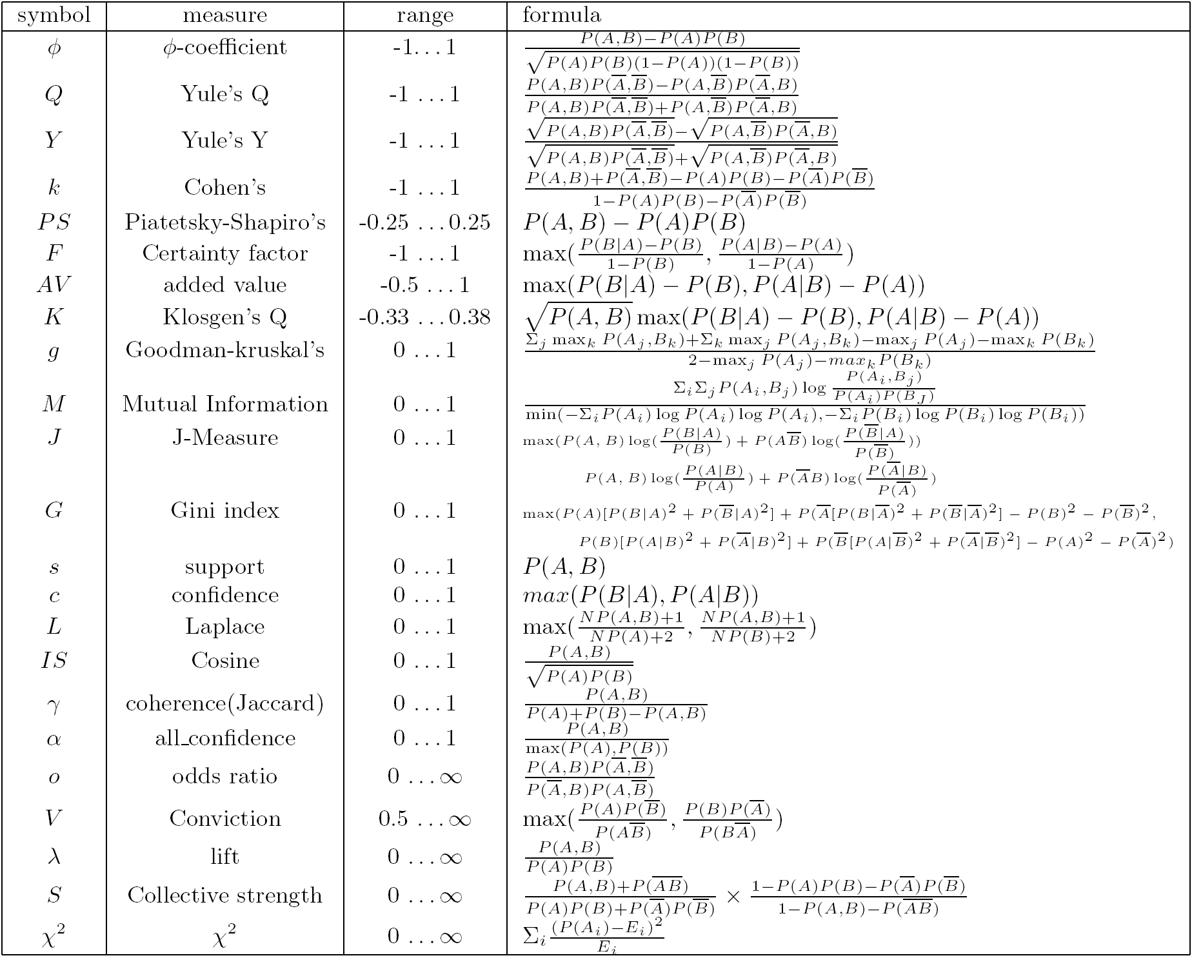
Are lift and χ² Good Measures of Correlation?

Slide 59
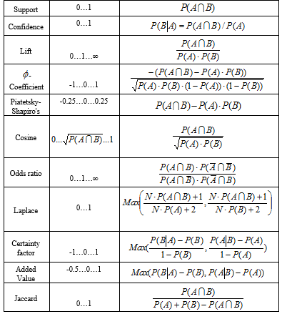
measurments

Slide 60
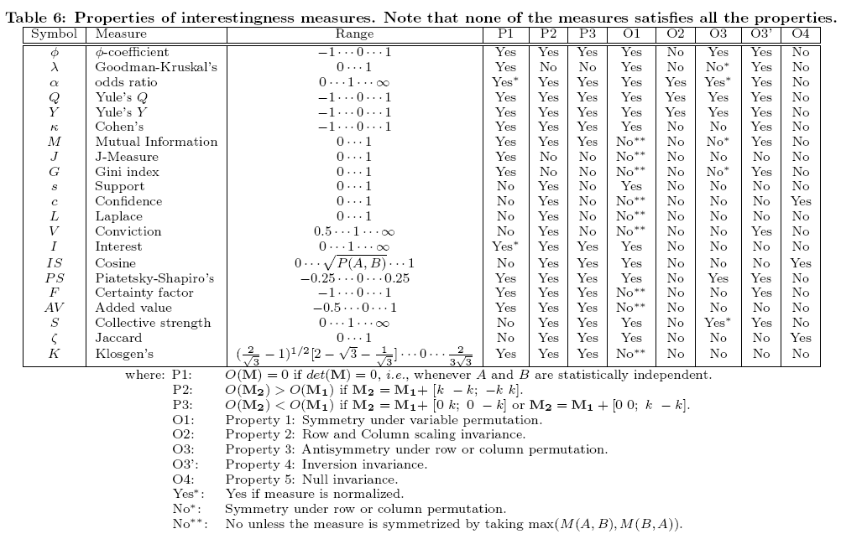
Null-Invariant Measures

Slide 61
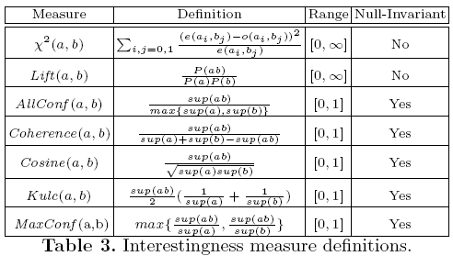
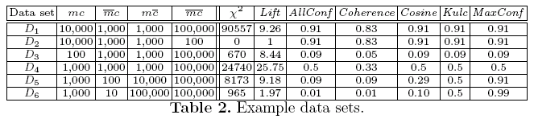
Comparison of Interestingness Measures
Null-(transaction) invariance is crucial for correlation analysis
Lift and χ² are not null-invariant
5 null-invariant measures
 | Milk | No Milk | Sum (row)
Coffee | m, c | ~m, c | c
No Coffee | m, ~c | ~m, ~c | ~c
Sum(col.) | m | ~m | Σ
Null-transactions w.r.t. m and c
Kulczynski measure (1927)
Null-invariant
Subtle: They disagree

Slide 62
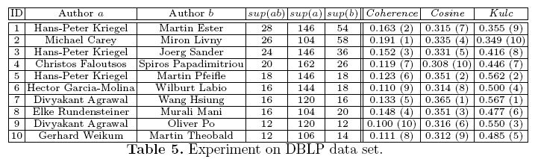
Analysis of DBLP Coauthor Relationships
Recent DB conferences, removing balanced associations, low sup, etc.
Advisor-advisee relation: Kulc: high, coherence: low, cosine: middle
Tianyi Wu, Yuguo Chen and Jiawei Han, “Association Mining in Large Databases: A Re-Examination of Its Measures”, Proc. 2007 Int. Conf. Principles and Practice of Knowledge Discovery in Databases (PKDD'07), Sept. 2007

Slide 63
Which Null-Invariant Measure Is Better?
IR (Imbalance Ratio): measure the imbalance of two itemsets A and B in rule implications
Kulczynski and Imbalance Ratio (IR) together present a clear picture for all the three datasets D₄ through D₆
  D₄ is balanced & neutral
  D₅ is imbalanced & neutral
  D₆ is very imbalanced & neutral

Slide 64
Chapter 5: Mining Frequent Patterns, Association and Correlations: Basic Concepts and Methods
Basic Concepts
Frequent Itemset Mining Methods
Which Patterns Are Interesting?—Pattern Evaluation Methods
Summary

Slide 65
Summary
Basic concepts: association rules, support-confident framework, closed and max-patterns
Scalable frequent pattern mining methods
  Apriori (Candidate generation & test)
  Projection-based (FPgrowth, CLOSET+, ...)
  Vertical format approach (ECLAT, CHARM, ...)

Slide 66
Ref: Basic Concepts of Frequent Pattern Mining
(Association Rules) R. Agrawal, T. Imielinski, and A. Swami. Mining association rules between sets of items in large databases. SIGMOD'93.
Projects for students
  (Max-pattern) R. J. Bayardo. Efficiently mining long patterns from databases. SIGMOD'98.
  (Closed-pattern) N. Pasquier, Y. Bastide, R. Taouil, and L. Lakhal. Discovering frequent closed itemsets for association rules. ICDT'99.
  (Sequential pattern) R. Agrawal and R. Srikant. Mining sequential patterns. ICDE'95

Slide 67
Ref: Apriori and Its Improvements
R. Agrawal and R. Srikant. Fast algorithms for mining association rules. VLDB'94.
H. Mannila, H. Toivonen, and A. I. Verkamo. Efficient algorithms for discovering association rules. KDD'94.
A. Savasere, E. Omiecinski, and S. Navathe. An efficient algorithm for mining association rules in large databases. VLDB'95.
J. S. Park, M. S. Chen, and P. S. Yu. An effective hash-based algorithm for mining association rules. SIGMOD'95.
H. Toivonen. Sampling large databases for association rules. VLDB'96.
S. Brin, R. Motwani, J. D. Ullman, and S. Tsur. Dynamic itemset counting and implication rules for market basket analysis. SIGMOD'97.
S. Sarawagi, S. Thomas, and R. Agrawal. Integrating association rule mining with relational database systems: Alternatives and implications. SIGMOD'98.

Slide 68
Ref: Depth-First, Projection-Based FP Mining
R. Agarwal, C. Aggarwal, and V. V. V. Prasad. A tree projection algorithm for generation of frequent itemsets. J. Parallel and Distributed Computing:02.
J. Han, J. Pei, and Y. Yin. Mining frequent patterns without candidate generation. SIGMOD’ 00.
J. Liu, Y. Pan, K. Wang, and J. Han. Mining Frequent Item Sets by Opportunistic Projection. KDD'02.
J. Han, J. Wang, Y. Lu, and P. Tzvetkov. Mining Top-K Frequent Closed Patterns without Minimum Support. ICDM'02.
J. Wang, J. Han, and J. Pei. CLOSET+: Searching for the Best Strategies for Mining Frequent Closed Itemsets. KDD'03.
G. Liu, H. Lu, W. Lou, J. X. Yu. On Computing, Storing and Querying Frequent Patterns. KDD'03.
G. Grahne and J. Zhu, Efficiently Using Prefix-Trees in Mining Frequent Itemsets, Proc. ICDM'03 Int. Workshop on Frequent Itemset Mining Implementations (FIMI'03), Melbourne, FL, Nov. 2003

Slide 69
Ref: Vertical Format and Row Enumeration Methods
M. J. Zaki, S. Parthasarathy, M. Ogihara, and W. Li. Parallel algorithm for discovery of association rules. DAMI:97.
Zaki and Hsiao. CHARM: An Efficient Algorithm for Closed Itemset Mining, SDM'02.
C. Bucila, J. Gehrke, D. Kifer, and W. White. DualMiner: A Dual-Pruning Algorithm for Itemsets with Constraints. KDD’02.
F. Pan, G. Cong, A. K. H. Tung, J. Yang, and M. Zaki , CARPENTER: Finding Closed Patterns in Long Biological Datasets. KDD'03.
H. Liu, J. Han, D. Xin, and Z. Shao, Mining Interesting Patterns from Very High Dimensional Data: A Top-Down Row Enumeration Approach, SDM'06.

Slide 70
Ref: Mining Correlations and Interesting Rules
M. Klemettinen, H. Mannila, P. Ronkainen, H. Toivonen, and A. I. Verkamo. Finding interesting rules from large sets of discovered association rules. CIKM'94.
S. Brin, R. Motwani, and C. Silverstein. Beyond market basket: Generalizing association rules to correlations. SIGMOD'97.
C. Silverstein, S. Brin, R. Motwani, and J. Ullman. Scalable techniques for mining causal structures. VLDB'98.
P.-N. Tan, V. Kumar, and J. Srivastava. Selecting the Right Interestingness Measure for Association Patterns. KDD'02.
E. Omiecinski. Alternative Interest Measures for Mining Associations. TKDE’03.
T. Wu, Y. Chen and J. Han, “Association Mining in Large Databases: A Re-Examination of Its Measures”, PKDD'07

Slide 71
Ref: Freq. Pattern Mining Applications
Y. Huhtala, J. Kärkkäinen, P. Porkka, H. Toivonen. Efficient Discovery of Functional and Approximate Dependencies Using Partitions. ICDE’98.
H. V. Jagadish, J. Madar, and R. Ng. Semantic Compression and Pattern Extraction with Fascicles. VLDB'99.
T. Dasu, T. Johnson, S. Muthukrishnan, and V. Shkapenyuk. Mining Database Structure; or How to Build a Data Quality Browser. SIGMOD'02.
K. Wang, S. Zhou, J. Han. Profit Mining: From Patterns to Actions. EDBT’02.

