Slide 1
ADVANCED TOPICS
IN INFORMATION RETRIEVAL AND WEB SEARCH
Lecture 2:
Information Retrieval vs. Search Engines
S. M. Vahidipour Vahidipour@kashanu.ac.ir

Slide 2
Outline
Main issues in IR and SE
Search engine architecture
  Indexing
  Querying

Slide 3
IR and Search Engines
A search engine is the practical application of information retrieval techniques to large scale text collections
Big issues include main IR issues but also some others…
Information Retrieval
Search Engines
Relevance: Effective ranking
Evaluation:Testing and measuring
Information needs: User interaction
Performance: Efficient search and indexing
Incorporating new data: Coverage and freshness
Scalability: Growing with data and users
Adaptability:Tuning for applications
Specific problems: e.g., Spam
Additional

Slide 4
Main Issues in IR
Relevance
  A relevant document contains the information a user was looking for when he/she submitted the query.
Evaluation
  How well does the ranking meet the expectation of the user.
Users and information needs
  Users of a search engine are the ultimate judges of quality.

Slide 5
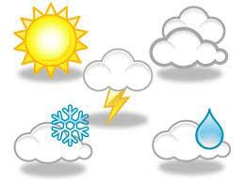
Relevance
Simple (and simplistic) definition:
  A relevant document contains the information that a person was looking for when they submitted a query to the search engine.
Many factors influence a person’s decision about what is relevant
  Task at hand, context, novelty, style, serendipity
Topical relevance vs. user relevance
  “Storm in Tehran last Sunday” is topically relevant to query “آب و هوا”…
  … but might not be relevant to user because
    Read it before
    Is five years old
    Is in a foreign language, etc.

Slide 6
Relevance
Retrieval models define a view of relevance
  Formal representation of the process of matching a query and a document
  Simple text matching is not sufficient: Vocabulary mismatch problem (synonyms and homonyms)
Ranking algorithms used in search engines are based on retrieval models
  Real-world search engines consider topical and user relevance
Most models describe statistical properties of text rather than linguistic
  i.e. counting simple text features, such as words, instead of parsing and analyzing the sentences
  Linguistic features can be part of a statistical model
Notes:
synonyms and homonyms
مترادف و همنام
Vocabulary mismatch is a common phenomenon in the usage of natural languages, occurring when different people name the same thing or concept differently.
نامگذاری متفاوت مفاهیم

Slide 7
Evaluation
Experimental procedures and measures for comparing system output with user expectations
  Originated in Cranfield experiments in the 60s
    First large scale “benchmark”
IR evaluation methods now used in many fields
Recall and precision are two examples of effectiveness measures

Slide 8
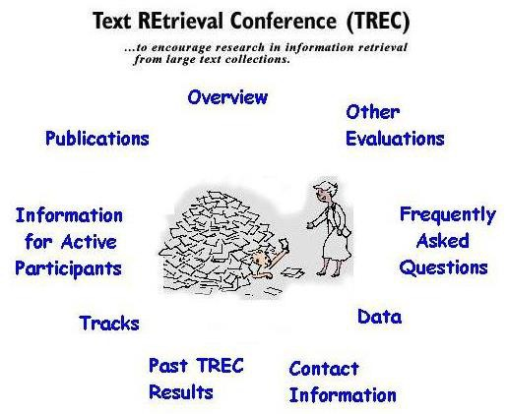
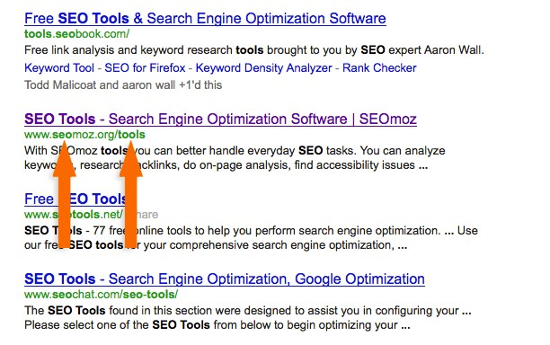
Evaluation
Typically use test collection (corpus) of documents, queries, and relevance judgments
  Most commonly used are TREC collections (Text REtrieval Conf.)
Clickthrough data to evaluate retrieval models and search engines.

Slide 9

Users and Information Needs
Search evaluation is user-centered
Keyword queries are often poor descriptions of actual information needs
  Query for “cats” could mean places to buy cats or the musical.
  Search queries (in particular one-word queries) are under-specified.
Interaction and context are important for understanding user intent
Query refinement techniques such as
  Query suggestion
  Query expansion and relevance feedback
Improve ranking

Slide 10
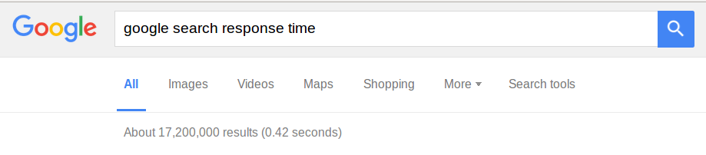
Performance
Measuring and improving the efficiency of search
  Reduce response time
  Increase query throughput
  Increase indexing speed
Indexes are data structures designed to improve search efficiency.
  Designing and implementing them are major issues for search engines.
Same tradeoffs as in DBMS

Slide 11
Dynamic Data
The “collection” for most real applications is constantly changing in terms of updates, additions, deletions
Acquiring or “crawling” the documents is a major task
  Typical measures are
    Coverage (how much has been indexed)
    Freshness (how recently was it indexed)
Quality
Freshness
Quantity
Notes:
Acquire بدست آوردن

Slide 12
Scalability
Making everything work with billions of users every day, and many terabytes of documents
Distributed processing is essential
But: Large ≠ scalable
Google in 2006 | Google in 2008 | Google in 2018
> 25 billion pages | • 1 trillion pages (1,000,000,000,000) | 130 trillion pages

Slide 13
Adaptability
Changing and tuning search engine components
  ranking algorithm
  indexing strategy
  interface for different applications
Adapt to different requirements for different applications / users
  New APIs
  New uses for search

Slide 14
Spam
For Web search, spam in all its forms is one of the major issues
Affects the efficiency of search engines and, more seriously, the effectiveness of the results
Many types of spam
  e.g., spamdexing or term spam, link spam, “optimization”
  http://en.wikipedia.org/wiki/Spamdexing
New subfield called adversarial IR, since spammers are “adversaries” with different goals
Notes:
Adversary دشمن
adversarial IR :IR دفاعی

Slide 15
Outline
Main issues in IR and SE
Search engine architecture
  Indexing
  Querying

Slide 16
Search Engine Architecture
Basic Building Blocks
Indexing
  Text Acquisition
  Text Transformation
  Index Creation
Querying
  User Interaction
  Ranking
  Evaluation

Slide 17
Search Engine Architecture
Determined by two main requirements
  Effectiveness (quality of results)
    As good as possible
  Efficiency (response time and throughput)
    As quickly as possible
Other requirements fall into these categories
  Changing documents -> Effectiveness and efficiency
  Personalization: Effectiveness
  Spam: Effectiveness and efficiency
○ …
Notes:
Effectiveness اثر بخشی
Efficiency کارآمد

Slide 18
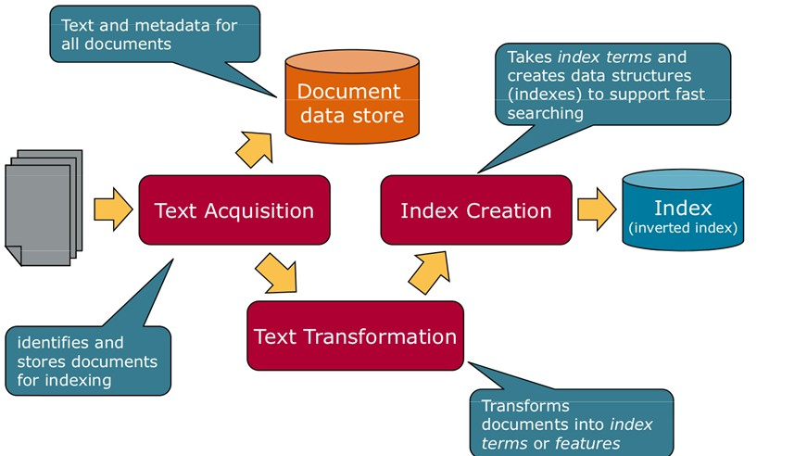
The Indexing Process

Slide 19
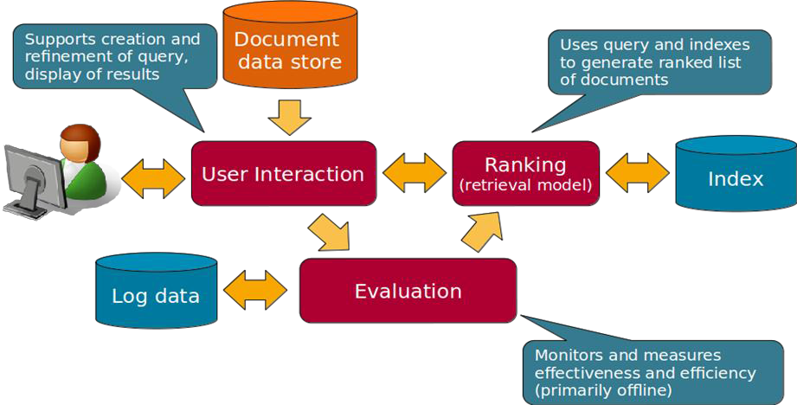
The Query Process

Slide 20
Outline
Main issues in IR and SE
Search engine architecture
  Indexing
  Querying

Slide 21
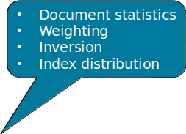



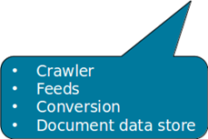


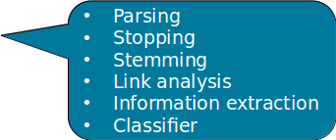
The Indexing Process
Document Data Store
Index

Slide 22
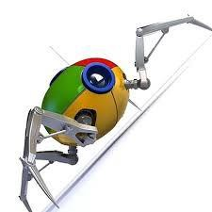
Text Acquisition – Crawler
Identifies and acquires documents for search engine
Many types
  Web, enterprise, desktop
Web crawlers follow links to find documents
  Must efficiently find huge numbers of web pages (coverage) and keep them up-to-date
(freshness)
  Single site crawlers for site search
  Topical or focused crawlers for vertical search
Document crawlers for enterprise and desktop search
  Follow links and scan directories

Slide 23
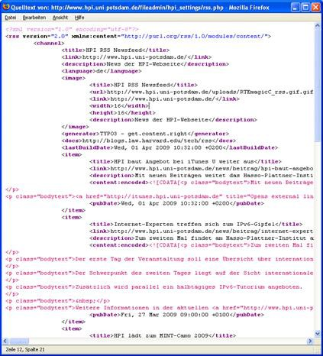

Text Acquisition – Feeds
Real-time streams of documents
  Web feeds for news, blogs, video, radio, TV
RSS is common standard
  RSS “reader” can provide new XML documents to search engine

Slide 24



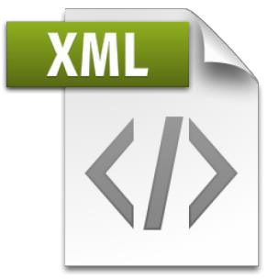
Text Acquisition – Conversion
Convert variety of document formats into a consistent text-plus-metadata format
  e.g., HTML, XML, Word, PDF, etc. → XML
Convert text encoding for different languages
  Using a standard like UTF-8
  Be consistent throughout application
Non-content data (tags, metadata) is either removed or stored as metadata.
First step towards text transformation

Slide 25
Text Acquisition – Document Data Store
Two parts
  Unstructured text
  Structured metadata
Stores text, metadata, and other related content for documents
  Metadata is information about document
    Type, creation date, …
  Other content includes links, anchor text
Why store documents? They are available on the Web anyway…
  Provide fast access to document contents for search engine components
    Result list generation, document summary, snippet
Document Data Store

Slide 26
The Indexing Process
Document Data Store
Index

Slide 27

Text Transformation – Parsing
Processing the sequence of text tokens in the document to recognize structural elements
  Titles, links, headings, etc.
Markup languages such as HTML, XML often used to specify structure
  Tags used to specify document elements
    E.g., <h2> Overview </h2>
  Document parser uses syntax of markup language (or other formatting) to identify structure
    E.g. email format, MS Word metadata etc.

Slide 28

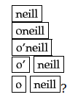



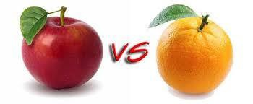
Text Transformation – Parsing
Tokenizer recognizes “words” in the text.
  Must consider issues like capitalization, hyphens, apostrophes, non-alpha characters, separators

Slide 29
Text Transformation – Stopping
Remove common words
○ “and”, “or”, “the”, “in”, …
Some impact on efficiency and effectiveness
Can be a problem for some queries
  “To be or not to be”

Slide 30
Text Transformation – Stemming
Group words derived from a common stem
  “computer”, “computers”, “computing”, “compute”
  “fish”, “fishing”, “fisherman”
Usually effective, but not for all queries
Benefits vary for different languages
  Arabic: Very complicated morphology
  Chinese: Few word variations anyway
Notes:
morphology
تاریخ تحولات لغوی

Slide 31
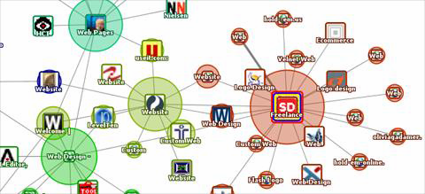
Text Transformation – Link Analysis
Makes use of links and anchor text in web pages.
  Stored and indexed separately
  <a href = http://www.kashanuu.ac.ir> University of Kashan</a>
Link analysis identifies popularity and community information
  e.g., PageRank
Anchor text can significantly enhance the representation of
pages pointed to by links
Significant impact on web search
  Less importance in other applications

Slide 32
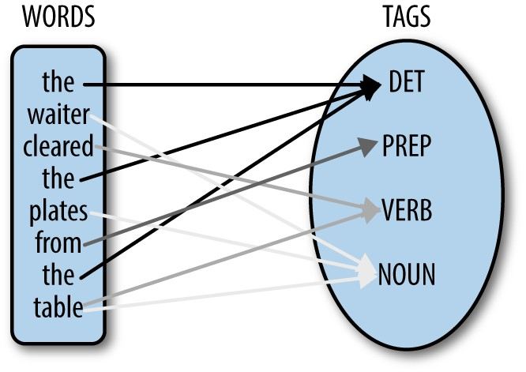

Text Transformation – Information Extraction
Identify classes of index terms that are important for some applications
Simple: Bold-face, heading, title
Part of speech tagging
Named entity recognizers (NER) identify classes such as
  People
  Locations
  Companies
  Dates
  etc.

Slide 33
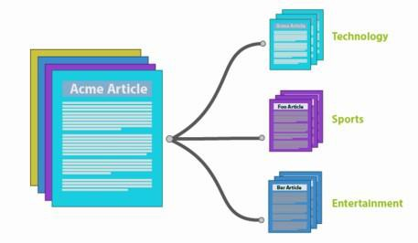
Text Transformation – Classifier
Identifies class-related metadata for documents
  i.e., assigns labels to documents
  e.g., topics, reading levels, sentiment, genre
  Spam!
  Advertisements in documents
Use depends on application
Notes:
Sentiment احساسات
Genre: ژانر

Slide 34
The Indexing Process
Document Data Store
Index

Slide 35

Index Creation - Document Statistics
Statistical information about words, features and documents
Gathers counts and positions of words and other features
  Within a document
  Across groups of documents
  Across all documents
Used in ranking algorithm

Slide 36
Index Creation – Weighting
Computes weights for index terms
  Relative importance of words in documents
  Used in ranking algorithm
Global weight
  Query-dependent weight
TF.IDF weight
  Combination of term frequency in document
  and inverse document frequency in the collection
Notes:
term's frequency (TF) این کلمه چند بار در متن آمده است
Its inverse document frequency (IDF) این کلمه به چه نسبتی در اسناد آمده است

Slide 37
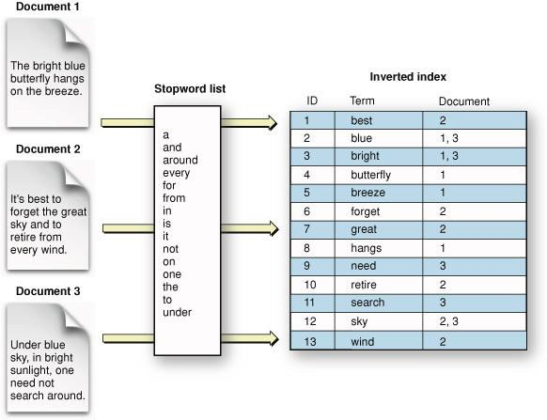
Index Creation – Inversion
Core of indexing process
Converts document-term information to
term-document for indexing
  Difficult for very large numbers of documents
  Classical Map/Reduce use case
Format of inverted file is designed for
fast query processing
  Must also handle updates
  Compression used for efficiency

Slide 38
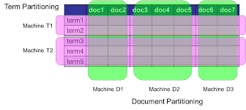
Index Creation – Index Distribution
Distribute indexes
  across multiple computers
  and/or multiple sites
Essential for fast query processing with large numbers of documents
Many variations
  Document distribution: Distribute index for subsets of documents
  Term distribution: Distribute index for subset of terms
  Replication

Slide 39
Outline
Main issues in IR and SE
Search engine architecture
  Indexing
  Querying

Slide 40

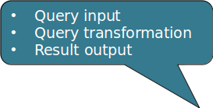
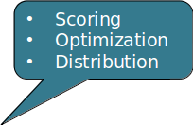
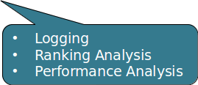
The Query Process

Slide 41
User Interaction - Query input
Provides interface and parser for internal query language
Most web queries are very simple
  Other applications may use forms
Query language used to describe more complex queries and results of query transformation
○ +, -, “ “, ~, site:, AND, OR, …
  Similar to SQL language used in database applications
    Not for “end users”
  IR query languages also allow structure specifications, but focus on content

Slide 42
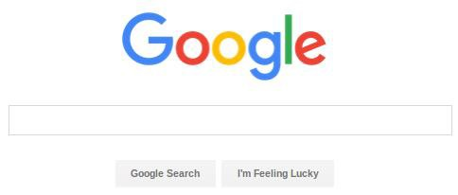
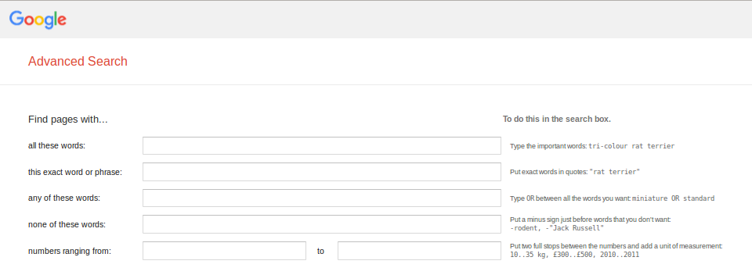
User Interaction - Query input

Slide 43
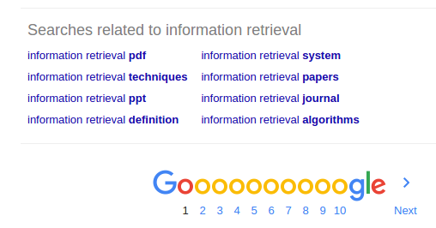
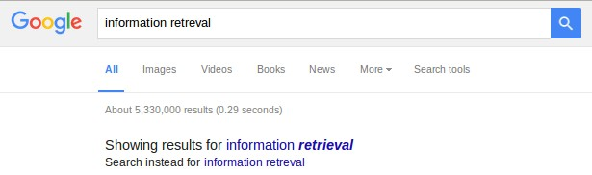
User Interaction – Query transformation
Improves initial query
  both before and after initial search
Includes same text transformation techniques used for documents
  Tokenization, stemming, stopping
Spell checking and query suggestion provide alternatives to original query
  Based on query logs
Query expansion and relevance feedback modify the original query with additional
terms

Slide 44
User Interaction – Results output
Constructs the display of ranked documents for a query
Generates snippets to show how queries match documents
Highlights important words and passages
Retrieves appropriate advertising in many applications
May provide clustering and other visualization tools
May translate results from foreign languages
Notes:
snippets قطعات

Slide 45
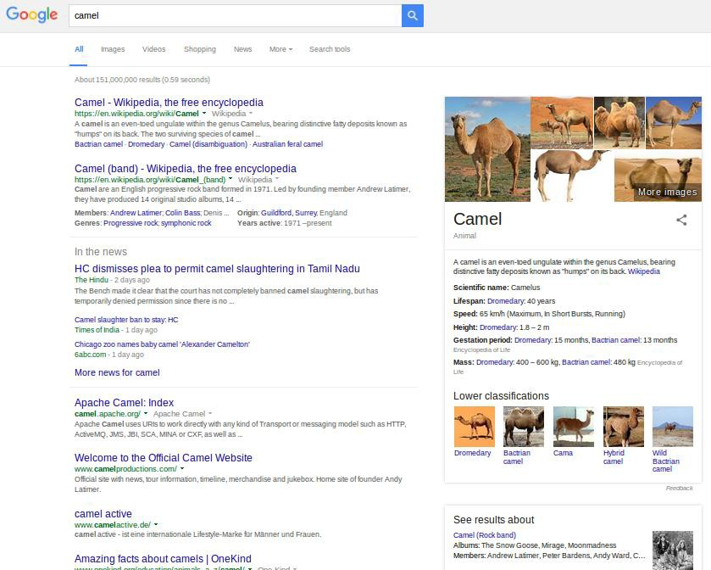
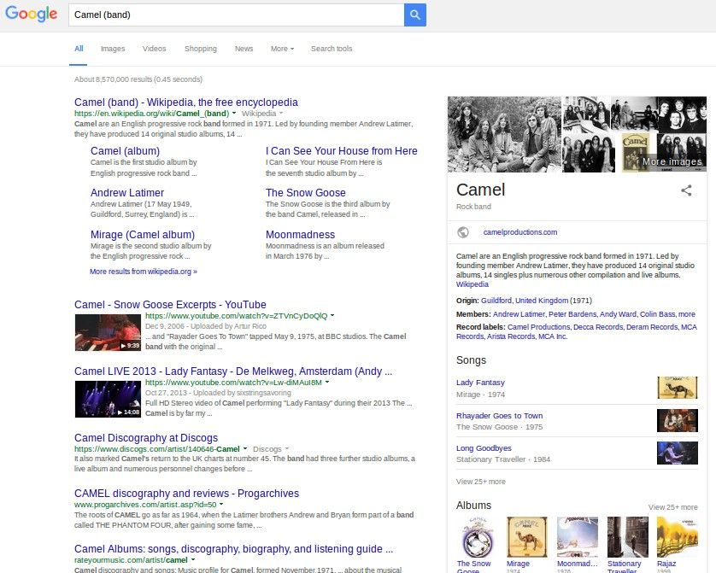
User Interaction – Results output

Slide 46
The Query Process

Slide 47
Ranking – Scoring
≈ database query processing
Calculates scores for documents using a ranking algorithm
  Based on retrieval model
Core component of search engine
Many variations of ranking algorithms and retrieval models
Key requirement: Fast execution!

Slide 48
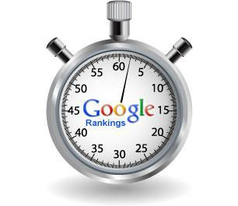
Ranking – Performance optimization
Designing ranking algorithms for efficient processing
  Term-at-a time vs. document-at-a-time processing
  Safe vs. unsafe optimizations
    Trade-off between speed and quality

Slide 49

Ranking – Distribution
Processing queries in a distributed environment
Query broker distributes queries and assembles results

Slide 50
The Query Process

Slide 51
Evaluation – Logging
Logging user queries and interaction is crucial for improving search effectiveness and efficiency.
Query logs and clickthrough data (& dwell time) used for
  Query suggestion
  Spell checking
  Query caching
  Ranking
  Advertising search
○ …
Assumption: Pages clicked on are relevant to query.
Notes:
dwell time زمان ماندگاری

Slide 52
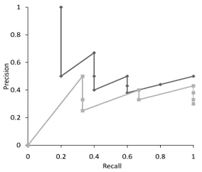
Evaluation – Ranking Analysis
Measuring and tuning ranking effectiveness
Variety of measures

Slide 53

Evaluation – Performance Analysis
Measuring and tuning system efficiency
Response time, throughput
Simulation

Slide 54
How Does It Really Work?
This course explains the components of a search engine in more detail.
Often many possible approaches and techniques for a given component
  Focus is on the most important alternatives
    Explain a small number of approaches in detail rather than many approaches
  “Importance” based on research results and use in actual search engines
  Alternatives described in references (see book)

Slide 55
Questions?

