Slide 1
ADVANCED TOPICS
IN INFORMATION RETRIEVAL AND WEB SEARCH
Lecture 4: Information Retrieval Evaluation
Dr. S. Mehdi Vahidipour
Thanks Dr. Momtazi
Vahidipour@kashanu.ac.ir
Based on the text book slides.

Slide 2
Outline
Introduction
Unranked vs ranked retrieval
Evaluation of unranked retrieval
Evaluation of ranked retrieval
Significant tests
Evaluation data and benchmarks
Evaluation at large scale data
Results representation

Slide 3
IR Evaluation
The key measure for a search engine is user happiness
Main factors in user happiness
Speed of response
Uncluttered UI
Relevance
Free to use
Note: none of these is sufficient
Blindingly fast, but useless answers won’t make a user happy
Notes:
Uncluttered بی سروصدا
Sufficient کافی

Slide 4
Relevance
User happiness is equated with the relevance of search results to the query
“Relevance to the query” is very problematic
Example
Information need: “I am looking for information on whether drinking milk is effective at reducing your
risk of heart attacks.”
Query: [milk reduce heart attack effect]
Sample document: "At the heart of his speech was an attack in the conference reception for reducing the
use of unhealthy elements in producing milk."
It is an excellent match for the query but not relevant to the information need.
Notes:
در قلب سخنرانی او حمله به کنفرانس برای کاهش استفاده از عناصر ناسالم در تولید شیر بود

Slide 5
Relevance
User happiness can only be measured by relevance to an information need, not by
relevance to queries
Our terminology is sloppy in IR: we talk about query-document relevance judgments even though we mean information-need-document relevance judgments
Notes:
Sloppy درهم و برهم

Slide 6
Evaluation Data
Standard methodology in information retrieval for measuring relevance consists of
three elements:
A benchmark document collection
A benchmark suite of queries
An assessment of the either relevant or nonrelevant for each pair of query and document
Notes:
A benchmark suite of queries
دنباله ای از کوئری

Slide 7
Outline
Introduction
Unranked vs ranked retrieval
Evaluation of unranked retrieval
Evaluation of ranked retrieval
Significant tests
Evaluation data and benchmarks
Evaluation at large scale data
Results representation

Slide 8
Unranked vs. Ranked Retrieval
Unranked retrieval
Returns a set of documents with no priority
A boolean classification as relevance and nonrelevance
Ranked retrieval
Returns a set of ranked documents
The position of document in the list is important

Slide 9
Precision and Recall
Required data
The set of relevant documents (but we may not find all)
The set of retrieved documents (but not all of them are relevant)
Precision (P) is the fraction of retrieved documents that are relevant
Precision = #(relevant items retrieved) / #(retrieved items) = P(relevant|retrieved)
Recall (R) is the fraction of relevant documents that are retrieved
Recall = #(relevant items retrieved) / #(relevant items) = P(retrieved|relevant)

Slide 10
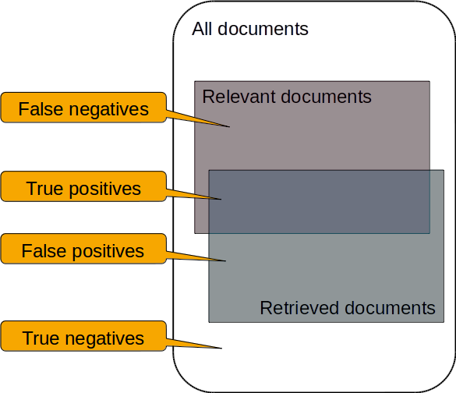
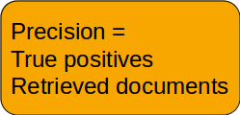
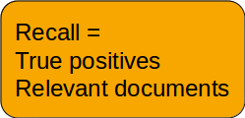
Notes:
Negative سامانه گفته مرتبط نیست و خروجی نداده
Positive سامانه گفته مرتبط هست و خروجی داده
True سامانه هر چی گفته درست بوده
False سامانه هر چی گفته غبط بوده

Slide 11
Precision/Recall Tradeoff
Find algorithm that maximizes precision.
Or minimizes classification errors (false positives)
Return nothing!
Find algorithm that maximizes recall.
Return everything!
Solution:
Considering both measures at the same time by F-Measure

Slide 12
F-Measure
General formula
α ∈ [0, 1] and thus β² ∈ [0, ∞]
Harmonic mean of recall and precision (β² =1)

Slide 13
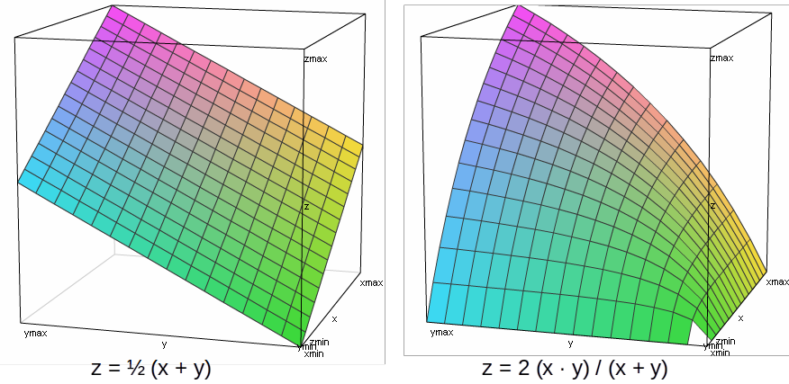
Arithmetic Mean (Average) vs Harmonic Mean (F-Measure)

Slide 14
Example
 | relevant | not relevant
retrieved | 20 | 40 | 60
not retrieved | 60 | 1,000,000 | 1,000,060
 | 80 | 1,000,040 | 1,000,120

Slide 15
Example
 | relevant | not relevant
retrieved | 20 | 40 | 60
not retrieved | 60 | 1,000,000 | 1,000,060
 | 80 | 1,000,040 | 1,000,120
_{P =} 20 ₌ 1
20 + 40 3
_{R =} 20 ₌ 1
20 + 60 4
₌ 2 ×1 / 3 ×1 / 4
1 / 3 + 1 / 4
F
1

Slide 16
Accuracy
Why not using a simpler measure like accuracy?
Accuracy is the fraction of decisions that are correct (relevant/nonrelevant) .
Accuracy = (TP + TN)/(TP + FP + FN + TN).
True Negative item is big enough to reduce the impact of other items
Simple trick: always say no and return nothing => get 99.99% accuracy on most queries
Searchers on the web (and in IR in general) want to find something and have a certain tolerance for
junk
It’s better to return some bad hits as long as you return something
→ We use precision, recall, and F for evaluation, not accuracy.

Slide 17
Outline
Introduction
Unranked vs ranked retrieval
Evaluation of unranked retrieval
Evaluation of ranked retrieval
Significant tests
Evaluation data and benchmarks
Evaluation at large scale data
Results representation

Slide 18
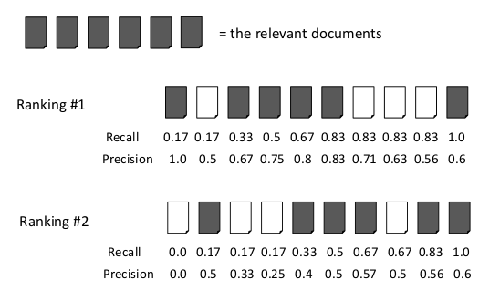
Ranking Effectiveness
Problem: Evaluate ranking, not just Boolean classification
Idea: Calculate precision and recall at every rank position

Slide 19
Ranking Effectiveness
Problem: Long lists are unwieldy and difficult to compare
Three ideas:
Calculating precision at standard recall levels, from 0.0 to 1.0 in increments of 0.1 => "Precision- Recall Curve"
Averaging the precision values from the rank positions where a relevant document was retrieved => "Average Precision"
Calculating precision at small number of fixed rank positions = > "Precision at rank k"
Ignores ranking after p; ignores ranking within 1 to p

Slide 20
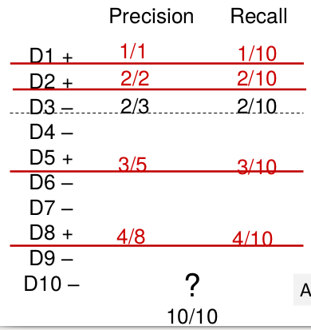
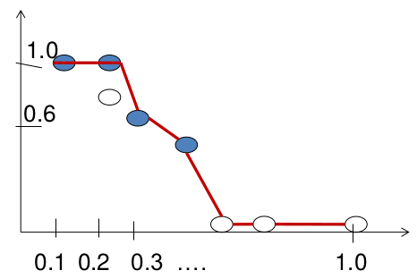
Precision-Recall (PR) Curve
Assume the total number of relevant documents in collection: 10
Consider the best precision
at each recall point
Notes:
if the (k + 1)th document retrieved is nonrelevant then recall is the same as for the top k documents, but precision has dropped.
If it is relevant, then both precision and recall increase, and the curve jags up and to the right.

Slide 21
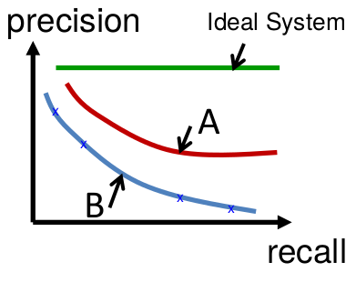
Precision-Recall (PR) Curve
Comparing PR Curves

Slide 22
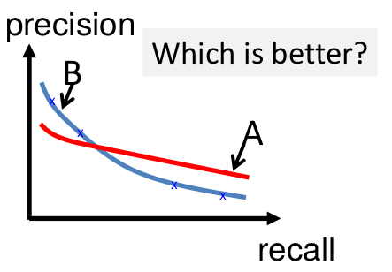
Precision-Recall (PR) Curve
Comparing PR Curves

Slide 23
Average Precision
The average of precision at every cutoff where a new relevant document is retrieved
Normalizer = the total # of relevant docs in the retrieved collection
Sensitive to the rank of each relevant document
AP = (1/1 + 2/2 + 3/5 + 4/8+….) / 10
AP = (1/1 + 2/2 + 3/5 + 4/8) / 4
Notes:
AP= average precision

Slide 24
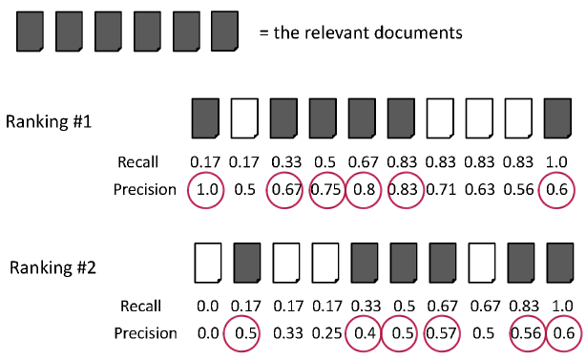
Average Precision
○ Ranking #1: (1.0+0.67+0.75+0.8+0.83+0.6) / 6 = 0.78
○ Ranking #2: (0.5+0.4+0.5+0.57+0.56+0.6) / 6 = 0.52

Slide 25
Mean Average Precision
Evaluate ranking algorithm for more than one query
Each ranking produces average precision
Take average of those numbers
=> Mean Average Precision (MAP) (= average average precision)
Most commonly used measure in research papers

Slide 26
Precision@k
Users tend to look at only the top part of the ranked result list to find relevant documents; e.g., first 1 or 2 result pages
Measure how well the search engine does at retrieving relevant documents at very high ranks
“Precision at Rank k”
K is typically 5, 10, 20
Easy to compute, easy to average over queries, easy to understand
But not sensitive to rank positions less than k
Single relevant document can be ranked anywhere
Alternative: Reciprocal Rank

Slide 27
Reciprocal Rank
Reciprocal of the rank at which the first relevant document is retrieved
Very sensitive to rank position, regards only first relevant document
Reciprocal rank: 1/2 Reciprocal rank: 1/3
Mean Reciprocal Rank (MRR) is the average of the reciprocal ranks over a set of queries
Notes:
Reciprocal متقابل

Slide 28
Discounted Cumulative Gain (DCG)
Popular measure for evaluating web search and related tasks
Uses graded relevance as a measure of the usefulness, or gain, from examining a document
Two assumptions
Highly relevant documents are more useful than marginally relevant document
The lower the ranked position of a relevant document, the less useful it is for the user, since it is less likely to be examined
Gain is accumulated starting at the top of the ranking
May be reduced, or discounted, at lower ranks
Typical discount is 1/log(rank)
With base 2, the discount at rank 4 is 1/2, and at rank 8 it is 1/3

Slide 29
Discounted Cumulative Gain (DCG)
DCG is the total gain accumulated at a particular rank p:
rel_{i} is graded relevance of document at rank i.
Can use “Bad” = 0 to “Perfect” = 3 or 5

Slide 30
Discounted Cumulative Gain (DCG)
Example:
10 ranked documents judged on 0-3 relevance scale (gain):
○ 3, 2, 3, 0, 0, 1, 2, 2, 3, 0
Discounted gain:
○ 3, | 2/1, | 3/1.59, | 0, | 0, | 1/2.59, | 2/2.81, | 2/3, | 3/3.17, | 0
= 3, | 2, | 1.89, | 0, | 0, | 0.39, | 0.71, | 0.67, | 0.95, | 0
Discounted Cumulative Gain at each position:
○ 3, 5, 6.89, 6.89, 6.89, 7.28, 7.99, 8.66, 9.61, 9.61
○ DCG@5 = 6.89 DCG@10 = 9.61

Slide 31
Normalized DCG
DCG values are often normalized by comparing the DCG at each rank with the DCG
value for the perfect ranking.
Makes averaging easier for queries with different numbers of relevant documents
=> NDCG ≤ 1 at any rank position

Slide 32
Normalized DCG
Example
Original result:
○ 3, 2, 3, 0, 0, 1, 2, 2, 3, 0
Original DCG values
○ 3, 5, 6.89, 6.89, 6.89, 7.28, 7.99, 8.66, 9.61, 9.61
Perfect ranking for the ten results:
○ 3, 3, 3, 2, 2, 2, 1, 0, 0, 0
Ideal DCG values:
○ 3, 6, 7.89, 8.89, 9.75, 10.52, 10.88, 10.88, 10.88, 10.88
NDCG values (divide actual by ideal):
○ 1, 0.83, 0.87, 0.76, 0.71, 0.69, 0.73, 0.8, 0.88, 0.88

Slide 33
Outline
Introduction
Unranked vs ranked retrieval
Evaluation of unranked retrieval
Evaluation of ranked retrieval
Significant tests
Evaluation data and benchmarks
Evaluation at large scale data
Results representation

Slide 34
Significance Tests
Given the results from a number of queries, how can we conclude that ranking
algorithm A is better than algorithm B?
Using an effectiveness metric: significant test
2 sets of data with normal distributions
A difference is considered significant if the probability of getting that difference by
random chance is very small

Slide 35
Hypothesis Tests
Hypothesis:
A statement which can be proven false
Null hypothesis (HO):
“There is no difference”
Alternative hypothesis (HA):
“There is a difference…”
Try to “reject the null hypothesis”
If the null hypothesis is false, it is likely that our alternative hypothesis is true
“False” – there is only a small probability that the results we observed could have occurred by chance

Slide 36
Significance Tests
A significance test enables us to reject the null hypothesis (“no difference”) in favor
of the alternative hypothesis (“B is better than A”)
A is baseline, B is “new and improved” version
The power of a test is the probability that the test will reject the null hypothesis correctly
Increasing the number of queries in the experiment also increases power of test

Slide 37
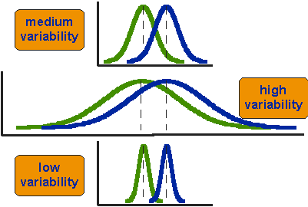
t-Test
Comparing the means of two groups is not enough
We need to consider the whole distribution

Slide 38
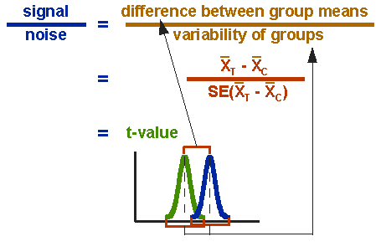
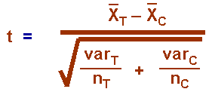
t-test
The formula for t-test is a ratio (signal-to-noise ratio)
Top part: difference between the two means or averages
Bottom part: a measure of the variability or dispersion of the scores
Notes:
SE= Standard Error
SE=standard deviation /n
VAR=Standard deviation ^2

Slide 39
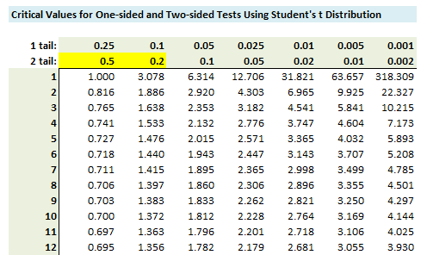
t-test
By computing the t-value, we have to look it up in the table of significance to test whether the ratio is large enough to say that the difference between the groups is not likely to have been a chance finding
P value:
The probability of making an error by chance Historically we use p < 0.05
Two tail vs one tail

Slide 40
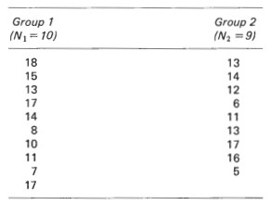
t-test
Example:
○ 𝑥₁ = 13.0
○ 𝑥₂ = 11.89
○ 𝑣𝑎𝑟₁ = 15.11
○ 𝑣𝑎𝑟₂ = 16.61
_{𝑡 =} 13.0−11.89 _{= 0.61}
○
15.11 16.61
+
10 9
○ 𝐷𝑒𝑔𝑟𝑒𝑒 𝑜𝑓 𝐹𝑟𝑒𝑒𝑜𝑚 𝑑𝑓=𝑛$1$+𝑛₂ −2=17
Minimum t-value in lookup table for df=17 and p<0.05: 2.11
=> the difference is not statistically significant

Slide 41
t-test
t-test for correlated samples (paired sampled)
Paired sample t-test is a statistical technique that is used to compare two population means in the
case of two samples that are correlated
Paired sample t-test is used in ‘before-after’ studies, or when the samples are the matched pairs, or when it is a case-control study
e.g., blood pressure of n patients, before & after a particular treatment

Slide 42
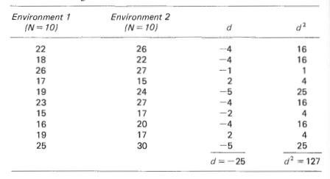
Example:
○ 𝑡 =
𝑑
=
−25
= −2.95
𝑁 𝑑²−( 𝑑)²
10×127 − (−25)²
𝑁−1
10−1
○ df = 𝑁 − 1 = 9
Minimum t-value in lookup table for df=9 and p<0.05: 2.263
=> the difference is statistically significant (it also satisfies p<0.02)

Slide 43
Outline
Introduction
Unranked vs ranked retrieval
Evaluation of unranked retrieval
Evaluation of ranked retrieval
Significant tests
Evaluation data and benchmarks
Evaluation at large scale data
Results representation

Slide 44
Evaluation Data
Goals
Provide fixed experimental setting and data
Ensure fair and repeatable experiments
Text corpus is without queries and relevance judgment
Linguistics, machine translation, speech recognition
Benchmarks includes test collection of
Documents
Queries
Relevance judgments

Slide 45
Evaluation Data
A collection of documents
Documents should be representative of the documents we expect to see in reality.
A collection of information needs (often incorrectly called queries)
Information needs should be representative of the information needs we expect to see in reality.
Human relevance assessments
We need to hire/pay “judges” or assessors to do this.
Expensive, time-consuming
Judges should be representative of the users we expect to see in reality.

Slide 46
First Standard Relevance Benchmark: Cranfield
Pioneering: first testbed allowing precise quantitative tests
Measures of information retrieval effectiveness
Late 1950s, UK
1398 abstracts of aerodynamics journal articles, a set of 225 queries, exhaustive
relevance judgments of all query-document-pairs
Too small, too untypical for serious IR evaluation today

Slide 47
Second-generation Relevance Benchmark: TREC
TREC = Text Retrieval Conference (TREC)
Organized by the U.S. National Institute of Standards and Technology (NIST)
TREC is actually a set of several different relevance benchmarks.
Best known: TREC Ad Hoc, used for first 8 TREC evaluations between 1992 and 1999

Slide 48
Second-generation Relevance Benchmark: TREC
TREC Ad Hoc task (1992 and 1999)
1.89 million documents, mainly newswire articles, 450 information needs
No exhaustive relevance judgments – too expensive
Result assessment: NIST assessors’ relevance judgments are available only for the documents that were among the top k returned for some system which was entered in the TREC evaluation for which the information need was developed.

Slide 49
More Recent Benchmark: ClueWeb09
1 billion web pages
25 terabytes (compressed: 5 terabyte)
Collected January/February 2009
10 languages
Unique URLs: 4,780,950,903 (325 GB uncompressed, 105 GB compressed)
Total Outlinks: 7,944,351,835 (71 GB uncompressed, 24 GB compressed)

Slide 50
Evaluation Corpora
Corpora change (in particular grow) over time
CACM
Titles and abstracts from the Communications of the ACM from 1958-1979
Queries and relevance judgments generated by computer scientists
AP
Associated Press newswire documents from 1988-1990 (from TREC disks 1-3)
Queries are the title fields from TREC topics 51-150
Topics and relevance judgments generated by government information analysts
GOV2
Web pages crawled from Web sites in the .gov domain during early 2004
Queries are the title fields from TREC topics 701-850
Topics and relevance judgments generated by government analysts

Slide 51
Validity of Relevance Assessments
Relevance assessments are only usable if they are consistent
If they are not consistent, then there is no “truth” and experiments are not repeatable
Measuring the consistency or agreement among judges
→ Kappa measure

Slide 52
Kappa Measure
Kappa is measure of how much judges agree or disagree.
Designed for categorical judgments and corrected for chance agreement
_{κ =} P( A) − P(E)
1− P(E)
P(A) = proportion of time judges agree
P(E ) = what agreement would we get by chance
Values of κ in the interval [2/3, 1.0] are seen as acceptable.
κ > 0.8 : good agreement
0.67 < κ < 0.8 : “tentative conclusions”
With smaller values: need to redesign relevance assessment methodology used etc

Slide 53
Kappa Measure
Example:
Total data: 400
Annotator 1: 320 relevant & 80 nonrelevant
Annotator 2: 310 relevant & 90 nonrelevant
Overlap: 300 relevant & 70 nonrelevant
20
300
10
70

Slide 54
Kappa Measure
Observed proportion of the times the judges agreed
○ 𝑃 𝐴
₌ 300+70 ₌ 370 _{= 0.925}
400 400
Probability that the two judges agreed by chance
Kappa statistic:
$κ =\frac{P(A_−P(E)}{(1−P(E)}=\frac{.925−.665}{1−.665}=.776$(in acceptable range)

Slide 55
Outline
Introduction
Unranked vs ranked retrieval
Evaluation of unranked retrieval
Evaluation of ranked retrieval
Significant tests
Evaluation data and benchmarks
Evaluation at large scale data
Results representation

Slide 56
Evaluation at Large Search Engines
Recall is difficult to measure on the web
Search engines often use precision at top k, e.g., k = 10 . . .
. . . or use measures that reward you more for getting rank 1 right than for getting rank 10 right.
Search engines also use non-relevance-based measures
Example: clickthrough on first result

Slide 57
Clickthrough Data
It can be obtained by observing how frequently the users click on a given document, when it is shown in the answer set for a given query
Clicks are not relevance judgments
… although they are highly correlated
Not very reliable if you look at a single clickthrough
You may realize after clicking that the summary was misleading and the document is nonrelevant . . .
. . . but pretty reliable in the aggregate
This is particularly attractive because the data can be collected at a low cost without overhead for the user
Notes:
. . . but pretty reliable in the aggregate
اما کاملا جمع و جور است

Slide 58
Clickthrough Data
Clickthrough data is difficult to interpret
Biased by a number of factors:
Rank on result list
Snippet
General popularity
Other indicators
Dwell time: time spent on a clicked result
Search exit action: result page, print page, timeout, enter other URL, …
Notes:
Snippet
General popularity
قطعه بندی جواب
محبوبیت عمومی
Search exit action نتیجه حاصل از جستجو

Slide 59
Outline
Introduction
Unranked vs ranked retrieval
Evaluation of unranked retrieval
Evaluation of ranked retrieval
Significant tests
Evaluation data and benchmarks
Evaluation at large scale data
Results representation

Slide 60
Results Representation
How do we present results to the user?
Most often: as a list; e.g., “10 blue links”
How should each document in the list be described?
This description is crucial
The user often can identify good hits (= relevant hits) based on the description
No need to actually view any document
Most commonly: doc title, url, some metadata . . .
. . . and a summary

Slide 61
Documents' Summaries
Two basic kinds:
Static
A static summary of a document is always the same, regardless of the query that was issued by the user.
Dynamic
Dynamic summaries are query-dependent. They attempt to explain why the document was retrieved for the query at hand.

Slide 62
Static Summaries
In typical systems, the static summary is a subset of the document.
Simplest heuristic: the first 50 or so words of the document
More sophisticated: extract from each document a set of “key” sentences
Simple NLP heuristics to score each sentence
Summary is made up of top-scoring sentences
Machine learning approach: see IIR 13
Most sophisticated: complex NLP to synthesize/generate a summary
For most IR applications: not quite ready for prime time yet

Slide 63
Dynamic Summaries
Present one or more “windows” or snippets within the document that contain several
of the query terms.
Prefer snippets in which query terms occurred as a phrase
Prefer snippets in which query terms occurred jointly in a small window
The summary that is computed this way gives the entire content of the window – all
terms, not just the query terms.
Criteria:
Occurrence of keywords, density of keywords, coherence of snippet, number of different snippets in
summary, good cutting points etc

Slide 64
Dynamic Summaries
Example

Slide 65
Dynamic Summaries
Tradeoff between short and long snippets
Snippets must be short, since real estate on the search result page is limited
Snippets must be long enough to be meaningful
Snippets should communicate whether and how the document answers the query
Ideally: linguistically well-formed snippets
Ideally: the snippet should answer the query, so we don’t have to look at the document.
Dynamic summaries are a big part of user happiness because …
. . . we can quickly scan them to find the relevant document we then click on
. . . in many cases, we don’t have to click at all and save time

Slide 66
Questions?

