Slide 1
ADVANCED TOPICS
IN INFORMATION RETRIEVAL AND WEB SEARCH
Lecture 1: Introduction
S. M. Vahidipour
Vahidipour@kashanu.ac.ir

Slide 2
Outline
Introduction to the Course
Overview of the Semester

Slide 3
Text Books
Search Engines:
Information Retrieval in Practice
W. Bruce Croft, Donald Metzler, Trevor Strohman
Pearson Education, 2010

Slide 4
Text Books
Modern Information Retrieval:
The Concepts and Technology behind Search (2nd Edition)
Ricardo Baeza-Yates, Berthier Ribeiro-Neto ACM Press Books, 2010

Slide 5
Text Books
Introduction to Information Retrieval
C. Manning, P. Raghavan, and H. Schütze Cambridge University Press, 2008

Slide 6
Search and Information Retrieval
Search on the Web is a daily activity for many people throughout the world
Google: 40,000 searches per second (3.5 billion per day; 1.2 trillion per year)
Yahoo: 3,200 searches per second (280 million per day; 8.4 billion per month)
Bing: 927 searches per second ( 80 million per day; 2.4 billion per month)
10⁶: Million, 10⁹: billion, 10¹²: Trillion, 10¹⁵: Quadrillion, 10¹⁸: Quintillion, …

Slide 7
Search and Information Retrieval
Search and communication are most popular uses of the computer.
Applications involving search are everywhere.
The field of computer science that is most involved with R&D for search is information retrieval (IR).

Slide 8
Information Retrieval
“Information retrieval is a field concerned with the structure, analysis, organization, storage, searching, and retrieval of information.”
(Salton, 1968)
General definition that can be applied to many types of information and search applications
Still appropriate after 40 years.
Primary focus of IR since the 50s has been on text and documents

Slide 9
Data/Information
Storage
Search

Slide 10
Data/Information
Structured
Unstructured

Slide 11
Structured vs. Unstructured Data

Slide 12
What is a Document?
Examples:
Web pages, email, books, news stories, scholarly papers, text messages, Word™, Powerpoint™, PDF, forum postings, patents, IM (Instant Messages) sessions, etc.
Common properties
Significant text content
Some structure (≈ attributes in DB)
Papers: title, author, date
Email: subject, sender, destination, date
Notes:
IM: instant messages

Slide 13
Comparing Text
Comparing the query text to the document text and determining what is a good match is the core issue of information retrieval.
Exact matching of words is not enough
Many different ways to write the same thing in a “natural language” like English
Does a news story containing the text “karl benz built the first automobile in 1886” match the query “car inverter”?
Defining the meaning of a word, a sentence, a paragraph, or a story is more difficult than defining the meaning of a database field.

Slide 14
Dimensions of IR
IR is more than just text, and more than just web search
although these are central
People doing IR work with different media, different types of search applications, and different tasks
Three dimensions of IR
Content
Applications
Tasks
20

Slide 15
The Content Dimension
Textual data, but…
New applications increasingly involve new media
Video, photos, music, speech
Scanned documents (for legal purposes)
Like text, content is difficult to describe and compare
Text may be used to represent them (e.g., tags)
IR approaches to search and evaluation are appropriate

Slide 16
The Application Dimension
Web search
Most common
Vertical search
Restricted domain/topic
Books, movies, suppliers
Enterprise search
Corporate intranet
Databases, emails, web pages, documentation, code, wikis, tags, directories, presentations, spreadsheets
Desktop search
Personal enterprise search
See above plus recent web pages
P2P search
No centralized control
File sharing, shared locality
Literature search
Forum search
…

Slide 17
The Task Dimension
User queries / ad-hoc search
Range of query enormous, not pre-specified
Filtering
Given a profile (interests), notify about interesting news stories
Identify relevant user profiles for a new document
Classification / categorization
Automatically assign text to one or more classes of a given set
Identify relevant labels for documents
Question answering
Similar to search
Automatically answer a question posed in natural language
Provide concrete answer, not list of documents.

Slide 18
Main Issues in IR
Relevance
A relevant document contains the information a user was looking for when he/she submitted the query
Evaluation
How well does the ranking meet the expectation of the user
Users and information needs
Users of a search engine are the ultimate judges of quality
Notes:
کاربران یک موتور جستجو قضات نهایی کیفیت هستند

Slide 19
IR and Search Engines
A search engine is the practical application of information retrieval techniques to large scale text collections
Big issues include main IR issues but also some others…
Information Retrieval
Search Engines
Relevance: Effective ranking
Evaluation: Testing and measuring
Information needs: User interaction
Performance: Efficient search and indexing
Incorporating new data: Coverage and freshness
Scalability: Growing with data and users
Adaptability: Tuning for applications
Specific problems: e.g., Spam
Additional
Notes:
جمع آوری داده های جدید

Slide 20
Outline
Introduction to the Course
Overview of the Semester

Slide 21
Search Engine
Basic architecture
Main issues
Indexing
Text acquisition
Text transformation
Index creation
Querying
User interaction
Ranking
Evaluation
Notes:
گرفتن متن

Slide 22
Overview of Traditional Retrieval Models
Boolean retrieval
Vector space model
Probabilistic models

Slide 23
Overview of Evaluation Metrics
Effectiveness metrics
Efficiency metrics
Training, testing, and statistics

Slide 24
Advanced Retrieval Models
Language model-based retrieval
Learning to rank
30

Slide 25
Word Mismatch Problem
Language model-based approaches
Translation model
Topic model
Word cluster model
Wordnet
Dependency model
Query expansion approaches

Slide 26
Advanced/Specific IR Tasks
Query log and query suggestion
Personalized search
Information extraction
Cross-language IR
Question answering
Recommendation systems
Enterprise search
Digital library
Structured text retrieval
Multimedia retrieval

Slide 27
Query Log and Query Suggestion

Slide 28
Personalized Search

Slide 29
Information Extraction

Slide 30
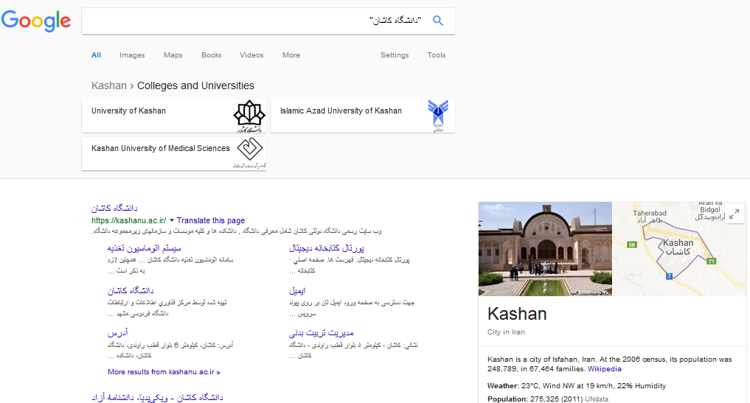
Cross-language Retrieval

Slide 31
Question Answering

Slide 32
Recommendation Systems

Slide 33
Enterprise Search
Notes:
Presans: مطبوعات

Slide 34
Digital Library
40

Slide 35
Structured Text Retrieval

Slide 36
Multimedia Retrieval

Slide 37
Questions?

